Slide 1






gmmoving.co.uk
Conference
2025
Sponsored by

Slide 2
Claire Marshall, GM Moving
&
Justine Blomeley, Merseyside Sport
With Contributions from Kate Peers, This Girl Can
Women & Girls Moving - The Art of Possible

Slide 3
Workshop Aims and Objectives
Provide a brief overview of the latest physical activity data around women and girls
To inform workshop attendees about what we are doing as 2 city regions to help tackle gendered inequalities around physical activity, movement and sport
To explore and discuss how a collective approach around a shared action plan could support greater change

Slide 4

Setting the Scene
Moving matters to all women and girls
Women and girls face additional barriers to an active life
Everyone has a role to play to close the gender activity gap

Slide 5
Active proportions have historically been lower for women compared to men
with an inequality gap of approximately 4 percentage points
Activity rates have not recovered to pre pandemic highs
Notes:
The overall picture for men and women
In greater Manchester the overall picture shows us that there is a gap between men and women when it comes to their activity levels.
Whilst the activity levels for both men and women has risen steadily since the pandemic there still remains a gap of approximately 4 percentage points.
Despite the consistent gap, things are moving in the right direction – activity levels for women have risen higher than they were when the survey was first carried out in 2015/16.

Slide 6

59% of women are active
Women get most of their active minutes through walking
Average weekly active minutes (females aged 16+)
Males
Females
Notes:
We can also use the data to explore the different activities that make up overall activity levels for women.
Walking for leisure being the most popular form of exercise with cycling being the least popular.
There is a significant gender gap when it comes to traditional sport with men spending significantly more time playing traditional sports than women.
35% of minutes from walking
41% of minutes from walking and gardening

Slide 7
Activity by age (life course)
Notes:
By taking a view across the life-course we can see how women’s activity levels change over time with the most significant dip occurring between the ages of 35-44 and a steady decline from 55 onwards.

Slide 8
Active proportions are lowest for women with a limiting illness or disability, outside the workforce, in NS SeC 6-8 or from minority ethnic groups
Notes:
breakdown by different demographics
The data can also then show us the further inequalities that exist, women with a limiting illness, those from low socio-economic, minority ethnic group and those not in work are all significantly less active that the average for women in GM.
By understanding these inequalities we can ensure that initiatives are targeted and designed to tackle the barriers faced by women in these least active groups.

Slide 9
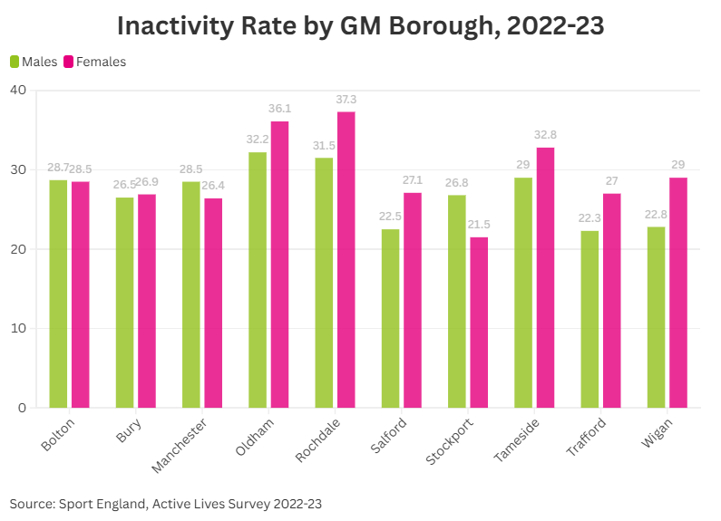
Notes:
And an overview of our borough data shows where the inequality gaps between men and women are greatest, but also in which boroughs women are most inactive. Interestingly, in 3 of our boroughs women are more inactive than men, particularly evident in Stockport. But, this really is just headline data and there will be intersectional inequalities that

Slide 10
A City Region Approach to Women and Girls
What - Greater Manchester and Liverpool City Regions working together around a shared aspiration to support more women and girls to feel they can access and enjoy physical activity safely, when they want and how they want
Why – Alignment and collaboration around shared priorities will help create more collective leadership and create the conditions for change
How - Summary of what we have done so far and future plans

Slide 11
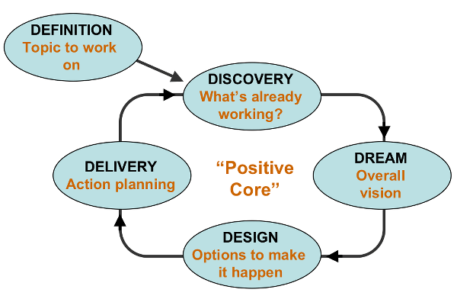
Appreciative Inquiry – What? So what? Now what?

Slide 12
Emerging themes from Appreciative Enquiry Task
Safety and inclusivity in public and leisure spaces
Shifts in cultural and social norms
Accessible and equality of opportunities
Data-driven change and accountability
Seamless and enjoyable active journeys
Notes:
Can this be a space to generate some interest in this as a collective. Get people to start thinking about where we already have some good stories to share and tell, where there may be opps to collaborate across our networks and systems.

Slide 13
What can help our joint commitment to help tackle gendered inequality?...
Understanding the data, insight and research.
Framing and messaging
Alignment and commitment around shared priorities
Lift up and share some of the great work going on around shared priorities
Notes:
Can this be a space to generate some interest in this as a collective. Get people to start thinking about where we already have some good stories to share and tell, where there may be opps to collaborate across our networks and systems.

Slide 14
This Girl Can
A national lottery funded campaign to help women from all backgrounds get active in ways which work for them
Now in its 10th year
Its campaigns are built on research, insight and collaborations
New phase of its campaign is pushing for change to ensure all women feel they belong in the world of physical activity
Insight | This girl can
Notes:
emphasing how the campaign insights are there to help, to really compliment the data and provide people with access to insight informed resources and tools to help us continue to engage more and more women and girls in what we do (and will support us in putting together our respective action plans).

Slide 15
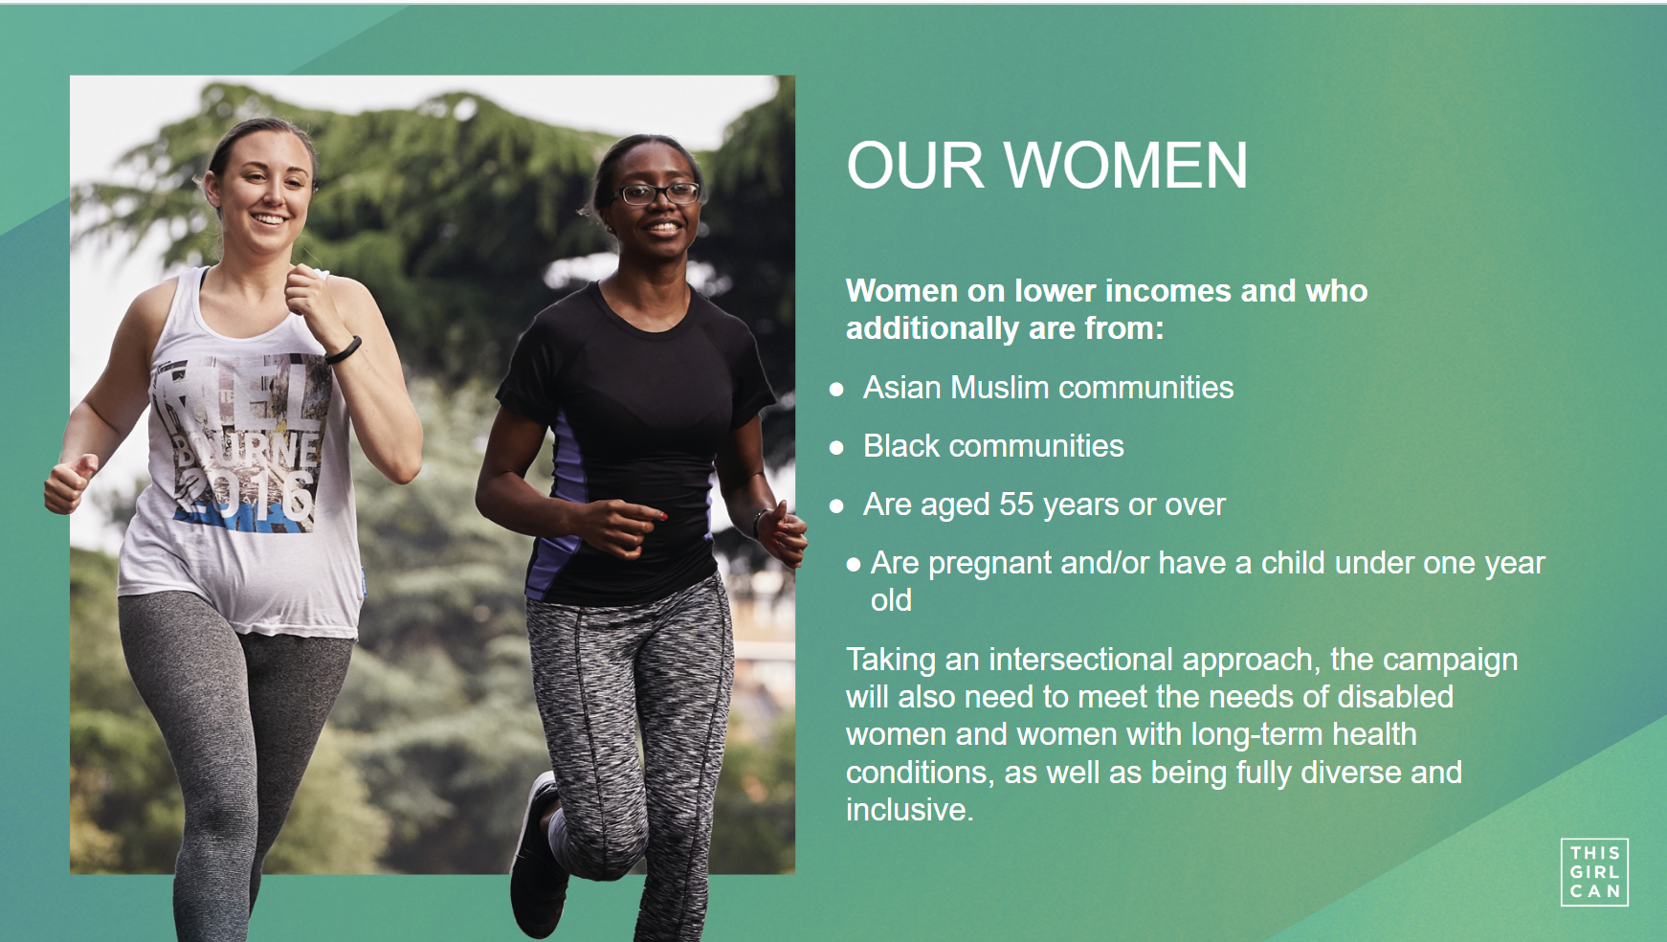

Slide 16
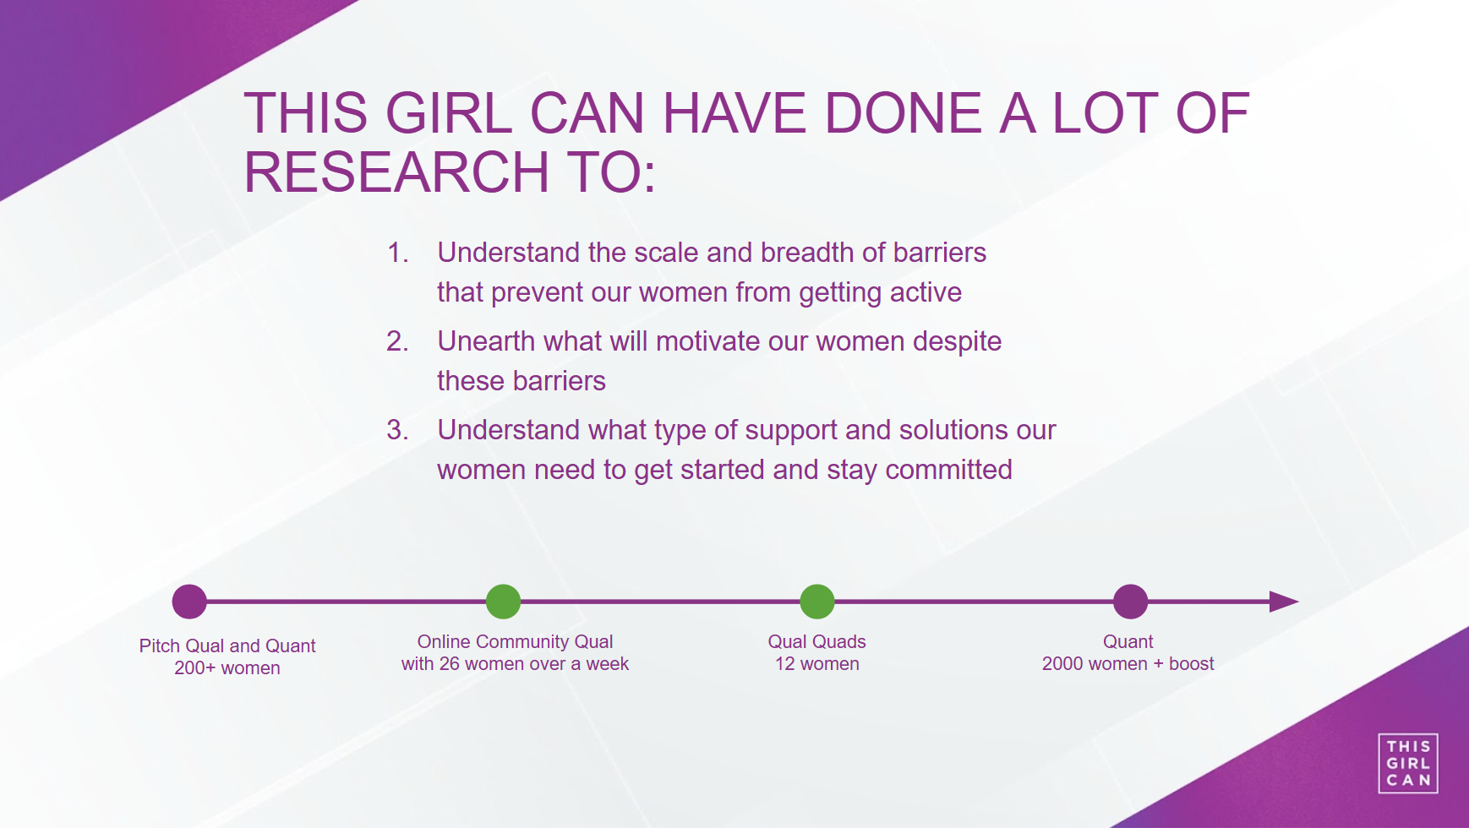

Slide 17
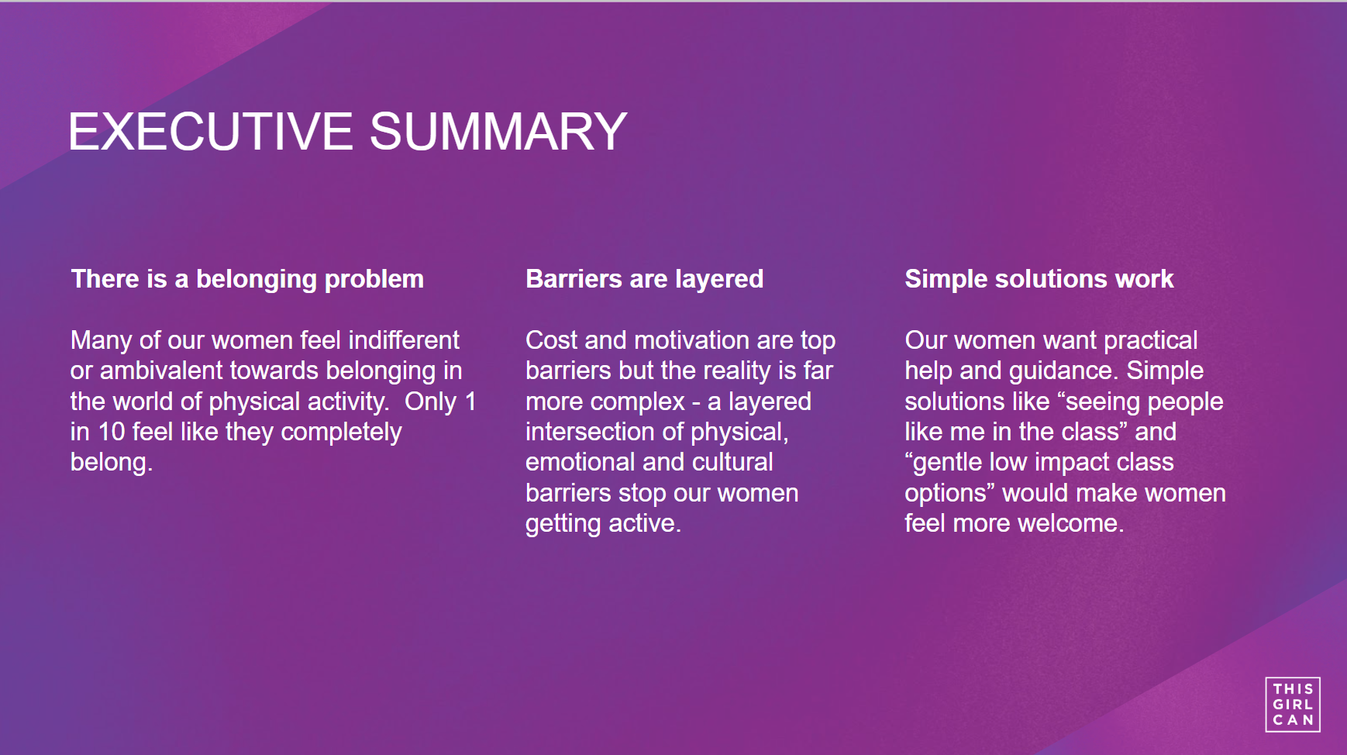

Slide 18
Brighton and Helsinki Declaration
Developed and endorsed by the IWG (International Working Group) on Women in Sport in 1994
IWG is a global network of networks – bringing together organisations that advance opportunities for women and girls in and through sport.
Advancing equality and equity, from grassroots through to elite.
Work covers a number of areas including: making the case for change, connection & collaboration, innovate and influence policy.
An international treaty to support the ongoing development of a more fair and equitable system of sport and physical activity, fully inclusive of women and girls
Every 4 years it hosts a Global Summit on Women - Birmingham 9th-11th July 2026

Slide 19
The 10 Principles
Equity and Equality in Society and Sport
Facilities
School and Youth Sport
Developing Participation
High Performance Sport
Leadership in Sport
Education, Training and Development
Sport Information and Research
Resources
Domestic and International Cooperation

Slide 20
What Next?
Aiming to sign up as 2 City regions to the declaration via our combined authorities
Use the 10 principles to help guide us in developing a shared action plan to build up to the International Working Group (IWG) Women & Sport conference in July 2026
Whole system leadership to change culture and shift barriers to active lives for women and girls
Engage and inspire other Mayoral Combined Authorities
Notes:
I think this workshop is a good way of inviting people in to start thinking about whether they want to contribute to a Region wide plan? Are they already doing things that already would be contributing? And if you're not do you want to be ? Do you think you should be ? Is this an opportunity for some real focus and energy? etc etc
Huge opportunity for us here to share our stories and work around place and partnerships

Slide 21
Task
From the 10 principles
Which of these resonate most strongly for you/your organisation?
Agree as a collective which we want to focus on (max 5)

Slide 22
The 10 Principles
Equity and Equality in Society and Sport
Facilities
School and Youth Sport
Developing Participation
High Performance Sport
Leadership in Sport
Education, Training and Development
Sport Information and Research
Resources
Domestic and International Cooperation

Slide 23
On tables, discuss and capture:-
What is already happening?
What could you commit to doing over the next 12 months to support this principle?
Is there anything that would help with this?
Notes:
This will help and support us compiling our action plan

Slide 24
Data & Insight
Feedback
What has resonated?
What are people interested in exploring further?
What and where could we facilitate some further
discussions/opportunities?

Slide 25
What can you do?
Become part of a network of organisations working in, across or for the interests of Greater Manchester supporting our sign up as a city region to the Brighton and Helsinki Declaration
Sign up to the IWG Women and Sport newsletter
Help us to build up examples of what’s happening in our city region on the resource hub
Sign up to the conference in Birmingham in 2026
Visit the TGC Campaign hub

Slide 26
IWG Brighton and Helsinki Declaration
Brighton Plus Helsinki Declaration | IWGIWG
This Girl Can Insight | This girl can
Belonging Starts with Inclusion toolkit | This girl can
Feel Good Your Way
Greater Manchester Moving
Contact
clairemarshall@gmmoving.co.uk

Slide 27


