Slide 1


Slide 2
Contents
What does our population look like?
Things were heading in the right direction…
And then something quite unique started…
Can we be sure it’s the pandemic?
So where does our concern lie now?
Summary

Slide 3
What does our population look like?
The population breakdown provides an insight into the demographic make up in your active partnership
Making comparisons to England will help to contextualise the physical activity data and aid understanding of its relevance to your active partnership

Slide 4
Why the make up of the local population is important
When comparing inactivity levels of a partnership area to England it is important to consider how the populations are different
Some demographic groups such as older adults have higher levels of inactivity compared to the whole population.
  If your partnership has a larger proportion of older people compared to England then you could expect higher levels of inactivity
  If your partnership has a smaller proportion, you could expect to have lower levels of inactivity
It is not quite as straight forward as this. As well as age other characteristics impact on inactivity levels such as disability, socio-economic group, ethnicity and a combination of other factors all impact on inactivity levels.
In 2121, within Greater Manchester there was a:
  Larger proportion of people with a limiting illness or disability (23% compared to 18% in England)
  Larger proportion of people in lower socio-economic groups (35% compared to 31%)
  Slightly smaller proportion of people aged 55 and over
Notes:
Notes from Derbyshire:
The age profile of Derbyshire appears slightly older than England which may impact on physical activity levels. Other factors which may have an impact include:
More people with a limiting illness
More people from NS SeC 6-8
Less people from ethnic minority groups
Local authorities
Local authorities differ quite a lot within Derbyshire
Bolsover has the highest proportion of people from NS SeC 6-8 and people with a limiting illness
Derbyshire Dales has the highest proportion of people aged 75+ but also the highest from NS SeC 1-2

Slide 5
Projected population growth in Greater Manchester
The total population of Greater Manchester is expected to grow by approximately 8% over the next 20 years
Within this the 65+ population is expected to grow by 30%
Source: ONS 2014, subnational projections
Notes:
England growth
Total pop 13.2%
65+ 38%

Slide 6
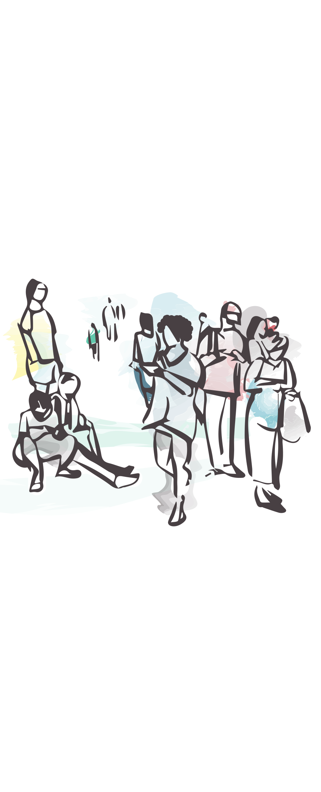
Things were heading in the right direction…

Slide 7
Adult physical activity levels were improving (significantly)...
Source: Sport England, Active Lives Adults, Nov 15/16 to Nov 19/20
Notes:
Both significantly

Slide 8
CYP physical activity was improving too…
Source: Active Lives Children and Young People Survey 2017-20
Notes:
Sample sizes are smaller for some of the demographic groups that are traditionally more likely to be ‘less active’. However, this should have been addressed through the weighing within the raw data

Slide 9
Improving levels of adult inactivity among our peers…
Source: Sport England, Active Lives Adults, Nov 15/16 to Nov 19/20
Notes:
Nearest neighbours are the same as we used for the initial pack in 2017?
Hampshire & Isle of Wight
London
West Yorkshire

Slide 10

8 of the 10 localities had improving levels of adult inactivity…
Source: Sport England, Active Lives Adults, Nov 15/16 to Nov 19/20

Slide 11
Inactivity was improving across nearly all adult demographic groups…
Source: Sport England, Active Lives Adults, Nov 15/16 to Nov 19/20

Slide 12
Adult sedentary behaviour appeared to be improving too…
Source: Sport England, Active Lives Adults, Nov 15/16 to Nov 19/20

Slide 13




And then something quite unique started…
A once in a 100 year international pandemic

Slide 14
Adult physical activity levels took a turn for the worse…
Source: Sport England, Active Lives Adults, Nov 15/16 to May 20/21

Slide 15
CYP physical activity may have been impacted too…
Source: Active Lives Children and Young People Survey 2017-20
Notes:
Sample sizes are smaller for some of the demographic groups that are traditionally more likely to be ‘less active’. However, this should have been addressed through the weighing within the raw data

Slide 16
Adult inactivity has fallen back among our peers…
Source: Sport England, Active Lives Adults, Nov 15/16 to Nov 19/20
Notes:
Nearest neighbours are the same as we used for the initial pack in 2017?
Hampshire & Isle of Wight
London
West Yorkshire

Slide 17
It has impacted on most localities but some more than others…
Source: Sport England, Active Lives Adults, Nov 15/16 to May 20/21

Slide 18
It has impacted across most adult demographic groups
Source: Sport England, Active Lives Adults, Nov 15/16 to May 20/21

Slide 19
Sedentary behaviour has grown…
453,000
people
179,000
people
29,000
people
Source: Sport England, Active Lives Adults, Nov 19/20
Notes:
There are approximately 110,000 more inactive people now compared to Nov 18/19

Slide 20
Can we be sure it’s the pandemic?

Slide 21
Covid-19 timeline
Source: Sport England Active Lives Nov 19/20 and the government website
Notes:
Dates of major political decisions
Full lockdown
Restrictions eased
Rule of 6
Activities phase in
Reopening of sporting venues
New restrictions

Slide 22
Inactivity increased during national lockdowns
Inactive population
by month
Source: Sport England Active Lives Nov 15/16 to Nov 19/20

Slide 23
The number of people doing ‘no sessions’ increased
Percentage doing ‘no sessions’
by month
Source: Sport England Active Lives Nov 15/16 to Nov 19/20

Slide 24
The average number of active minutes reduced
Average minutes of physical activity per week, by month
Source: Sport England Active Lives Nov 15/16 to Nov 19/20
Notes:
*Duration, minutes per week:
The average number of minutes per week of a specific sport or activity at moderate intensity:
Moderate intensity equivalent (MIE) minutes means each ‘moderate’ minute counts as one minute
Any vigorous activity counts for double, so each vigorous minute counts as two moderate minutes
Light intensity minutes are excluded
For some activities, intensity was assumed and not asked (assumed always to be light, moderate or vigorous). Activities done by those aged 65 and over were assumed to be at least moderate

Slide 25
Most adult demographic groups saw an increase in inactivity
Inactive population
Source: Sport England Active Lives Nov 15/16 to Nov 19/20
Notes:
Sport England measure and therefore does not take gardening into consideration

Slide 26
Most adult demographic groups saw an increase in inactivity
Source: Sport England, Active Lives Adults, Nov 15/16 - Nov 19/20 – Mar to November data
Notes:
Mar-Nov values
2015-19
White British 6209 of 24743
White Other 349 of 1458
South Asian 683 of 1849
Black 197 of 571
Chinese 71 of 223
Mixed 84 of 360
Other ethnic group 100 of 295
2020
White British 1738 of 5899
White Other 92 of 350
South Asian 240 of 502
Black 75 of 160
Chinese 29 of 71
Mixed 24 of 109
Other ethnic group 33 of 83

Slide 27
Most adult demographic groups saw an increase in sedentary behaviour
Percentage doing ‘no sessions’
Source: Sport England Active Lives Nov 15/16 to Nov 19/20
Notes:
Sport England measure and therefore does not take gardening into consideration
*Sessions must last at least 10 minutes and be of at least moderate intensity within the last 28 days

Slide 28
Most adult demographic groups saw a decrease in average minutes per week
Average minutes of physical activity
per week
Source: Sport England Active Lives Nov 15/16 to Nov 19/20
Notes:
Average minutes includes gardening.
Duration, minutes per week
The average number of minutes per week of a specific sport or activity at moderate intensity. Moderate intensity equivalent (MIE) minutes means each ‘moderate’ minute counts as one minute. Any vigorous activity counts for double, so each vigorous minute counts as two moderate minutes. Light intensity minutes are excluded. For some activities, intensity was assumed and not asked (assumed always to be light, moderate or vigorous). Activities done by those aged 65 and over were assumed to be at least moderate

Slide 29
The pandemic has shifted how we get our minutes…
Traditional sport has dropped with the closure of sports venues, restriction on activities and change of people’s habits
Walking for travel has reduced as schools closed and people were encouraged to work from home
Walking for leisure has seen a large increase of 8pp and now accounts for a third of all physical activity minutes
People spend more time gardening. Gardening has increased by 6pp and now accounts for around 1 in 5 of all physical activity minutes
Fitness activities have decreased. Additionally habits will have changed with gyms closing and more people exercising from home
Cycling rates have increased from previous years
Data for Greater Manchester
Source: Sport England Active Lives Nov 15/16 to Nov 19/20
Notes:
Traditional sport includes (from the Technical Notes):
Team Sports: Football, Cricket, Rugby union, Rugby league, Touch rugby, Wheelchair rugby, Netball, Basketball, Wheelchair basketball, Field hockey, Volleyball, Rounders, Dodgeball, Baseball or softball, Lacrosse, Goalball, Handball, Gaelic sports, Other team sport. Racket Sports: Tennis, Badminton, Squash or Racketball, Table Tennis. Adventure sports: Hill or mountain walking or hiking, Rock climbing or bouldering, Climbing or bouldering wall, Caving or pot holing, Abseiling, Orienteering, Parkour or free running, High ropes. Water sports: Rowing, Sailing, Windsurfing, Gliding, paragliding or hang gliding, Canoeing or kayaking, Rafting, Water skiing or wakeboarding, Surfing, board surfing, body boarding, kite surfing, paddle boarding, Scuba diving or snorkelling, Life-saving, Other water sports such as dragon boat racing. Leisure games and activities: Angling or fishing, Archery, Fencing, Ice skating, Frisbee or ultimate Frisbee, Rounders, Garden trampolining, Ten-pin bowling, Ipsos MORI | Active Lives Survey – Year 1 – Technical Report 11 17-071413-01 | Version 1 | Public | This work was carried out in accordance with the requirements of the international quality standard for Market Research, ISO 20252:2012, and with the Ipsos MORI Terms and Conditions which can be found at http://www.ipsos-mori.com/terms. © Ipsos MORI 2017 Croquet, Cue based sports (e.g. billiards, snooker and pool), Darts, Skittles, Other leisure activity or game. Combat sports, Martial Arts or Target Sports: Archery, Boxing, Fencing, Judo, Taekwondo, Martial arts, Shooting, Wrestling, Tai Chi Winter sports: Skiing, Snowboarding, Sledding, luge, tobogganing, Ice hockey, Curling, Ice skating, Other winter sports. Swimming, diving or water polo: Swimming indoors and outdoors, Diving, Water polo. Running, athletics or multi-sports: Track and field athletics, Running or jogging, Fell or trail running, Triathlon (includes aquathlon and duathlon), Modern Pentathlon, Obstacle course (e.g. Tough mudder, Spartan, Rat Race). Golf. Horse riding. Bowls or Boules. Gymnastics, trampolining or cheerleading. Roller or skating sports: Roller-skating, inline skating, rollerblading, Roller hockey, Skateboarding, Ice skating. Motorsports: Karting or go-karting, Motorcycle racing, Motorcar racing.

Slide 30
Moderate intensity minutes by NS SeC group (Greater Manchester)
2016-2019
2020
NS SeC 1-2
NS SeC 3-5
NS SeC 6-8
Walking for leisure Walking for travel Gardening Traditional sport Fitness activities Cycling
Source: Sport England, Active Lives Adults, Nov 15-16 to Nov 19/20
Notes:
Mean minutes
Year 1-4 Year 5
NS SeC 1-2 595.5 587.6
NS SeC 3-5 533.4 530.1
NS SeC 6-8 482.5 450.4

Slide 31
Moderate intensity minutes by ethnicity (Greater Manchester)
2016-2019
2020
White British
White other
Black
Walking for leisure Walking for travel Gardening Traditional sport Fitness activities Cycling
Source: Sport England, Active Lives Adults, Nov 15-16 to Nov 19/20
Notes:
Mean minutes
Year 1-4 Year 5
White British 570.6 587.1
White other 581.8 480.3
Black 406.7 387.8

Slide 32
Moderate intensity minutes by ethnicity (Greater Manchester)
2016-2019
2020
South Asian inc Chinese
Mixed
Other ethnic groups
Walking for leisure Walking for travel Gardening Traditional sport Fitness activities Cycling
Source: Sport England, Active Lives Adults, Nov 15-16 to Nov 19/20
Notes:
Mean minutes
Year 1-4 Year 5
South Asian inc Chinese 398.2 287.3
Mixed 556.1 473.9
Other ethnic groups 377.9 321.0

Slide 33
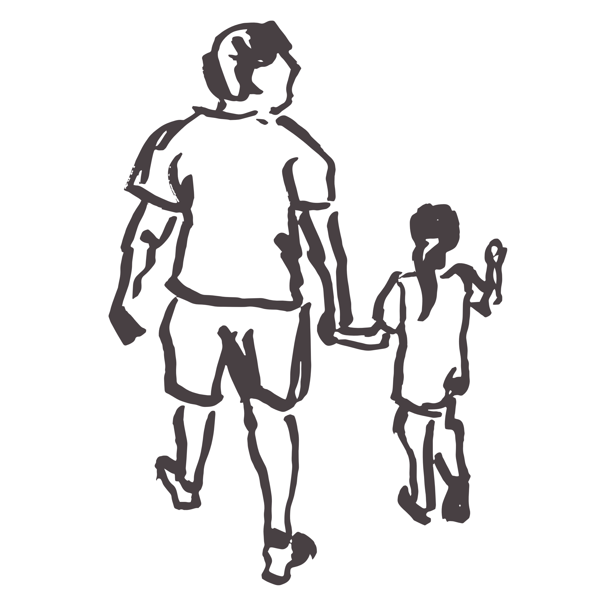
So where does our concern lie now?

Slide 34
Gender and age
Source: Sport England, Active Lives Adults, Nov 15/16 to Nov 19/20 5 years combined
Notes:
16-19 157 of 769 206 of 1015 20-24 171 of 839 282 of 1461 25-29 251 of 1464 477 of 2371 30-34 438 of 1889 650 of 2731 35-39 468 of 1980 671 of 2877 40-44 448 of 2011 556 of 2563 45-49 495 of 2092 572 of 2496 50-54 519 of 2078 646 of 2521 55-59 605 of 2118 703 of 2514 60-64 604 of 2240 812 of 2600 65-69 709 of 2578 825 of 2565 70-74 706 of 2068 768 of 2070 75-79 494 of 1192 502 of 1062 80-84 311 of 631 387 of 626 85-89 180 of 270 213 of 281 90-94 55 of 69 81 of 96 95+ 16 of 23 26 of 32 90+ 71 of 92 107 of 128

Slide 35
Gender and NS SeC
Source: Sport England, Active Lives Adults, Nov 15/16 to Nov 19/20 5 years combined
Notes:
Male Female NS SEC 1-2: Managerial, administrative and professional occupations 1964 of 10984 2948 of 14577 NS SEC 3: Intermediate occupations 298 of 1157 1313 of 4766 NS SEC 4: Self employed and small employers 609 of 1892 252 of 931 NS SEC 5: Lower supervisory and technical occupations 916 of 2933 304 of 934 NS SEC 6-7: Semi-routine and routine occupations 1057 of 2817 1176 of 3091 NS SEC 8: Long term unemployed or never worked 238 of 632 467 of 971 NS SEC 9: Students and other 529 of 1790 782 of 2654

Slide 36
Gender and deprivation
Source: Sport England, Active Lives Adults, Nov 15/16 to Nov 19/20 5 years combined
Notes:
Least deprived decile 302 of 1503 359 of 1655 2 352 of 1747 444 of 2058 3 470 of 2119 536 of 2477 4 432 of 1966 593 of 2380 5 355 of 1501 463 of 1838 6 470 of 1889 555 of 2347 7 519 of 1924 687 of 2500 8 749 of 2777 939 of 3556 9 1013 of 3394 1300 of 4245 Most deprived decile 2038 of 5625 2611 of 7050

Slide 37
Gender and ethnicity
Source: Sport England, Active Lives Adults, Nov 15/16 to Nov 19/20 5 years combined
Notes:
White British 5064 of 19587 6526 of 24398
White Other 282 of 1121 355 of 1464
South Asian 598 of 1612 710 of 1767 Black 177 of 468 214 of 599 Chinese 54 of 175 87 of 240 Mixed 59 of 256 102 of 432 Other ethnic group 87 of 254 110 of 289

Slide 38
Age and limiting illness
Average age by condition
Source: Sport England, Active Lives Adults, Nov 15/16 to Nov 19/20 5 years combined
Source: Sport England, Active Lives Adults, Nov 19/20
Notes:
Sample sizes
Limiting illness
1335 of 3915 3196 of 6019 No limiting illness 5176 of 25559 4113 of 15525

Slide 39
Age and work status
Source: Sport England, Active Lives Adults, Nov 15/16 to Nov 19/20 5 years combined
Notes:
Working full time 3512 of 18386 1076 of 3800 Working part time 1134 of 4924 653 of 2572 Unemployed 503 of 1514 165 of 393 Not working-retired 45 of 159 4825 of 13692 Not working-looking after house/children 462 of 1506 84 of 236 Not working-long term sick or disabled 516 of 987 505 of 813 Student 426 of 2434 5 of 29 Other 294 of 875 229 of 633

Slide 40
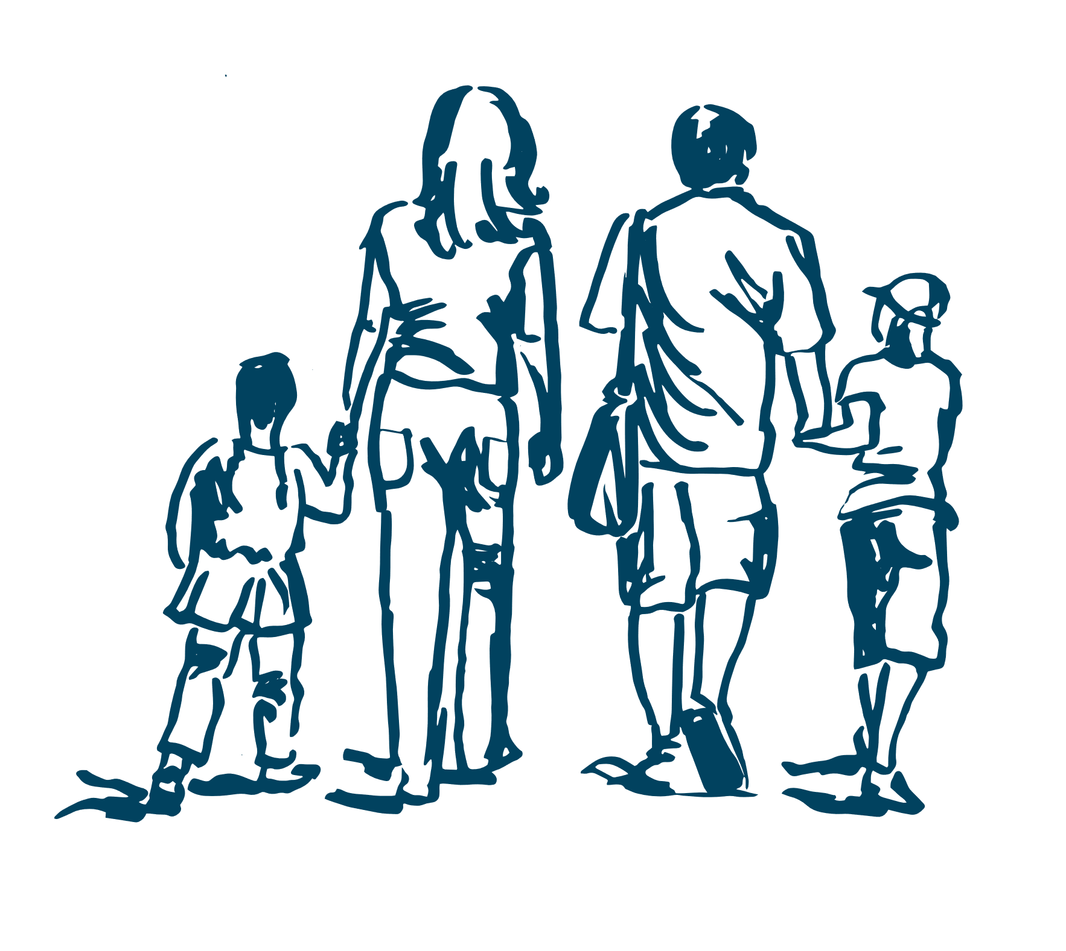
Children and young people
So where does our
concern lie now?

Slide 41
Physical activity, by FAS and gender, year 3-6
Source: Sport England Active Lives Children and Young People Survey 2017-20 3 years combined
Notes:
Percentage who are active: Achieving an average of 60 minutes or more a day

Slide 42
Physical activity, by FAS and gender, year 3-6
Source: Sport England Active Lives Children and Young People Survey 2017-20 3 years combined

Slide 43
Physical activity, by FAS and gender, year 7-11
Source: Sport England Active Lives Children and Young People Survey 2017-20 3 years combined
Notes:
Percentage who are active: Achieving an average of 60 minutes or more a day

Slide 44
Physical activity, by FAS and gender, year 7-11
Source: Sport England Active Lives Children and Young People Survey 2017-20 3 years combined
Notes:
Where ‘active’ is an average of 30 minutes or more a day (in the specified setting)

Slide 45

Summary

Slide 46
We need to think a bit more carefully about the nuances in behaviour…
Source: Sport England, Active Lives Adults, Nov 19/20

Slide 47
We need to think a bit more carefully about the nuances in behaviour…
Source: Sport England, Active Lives Adults, Nov 19/20

Slide 48
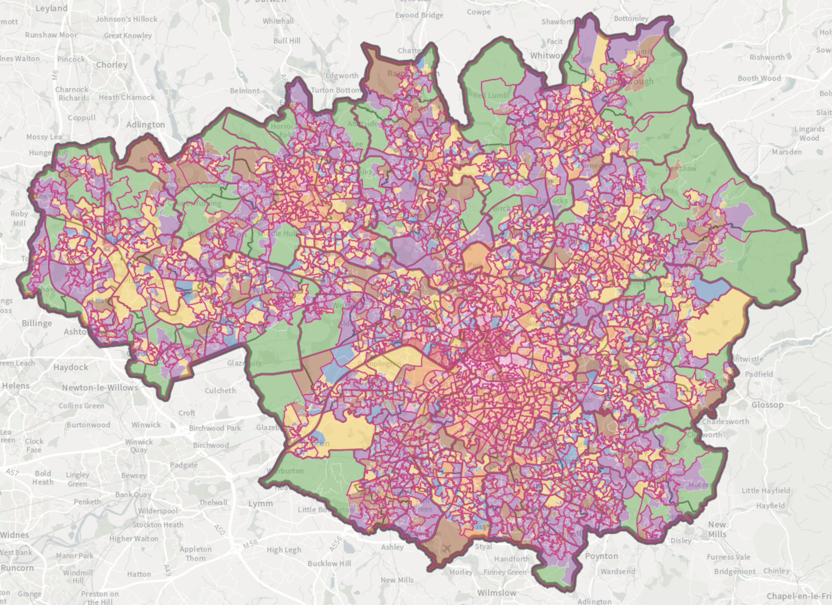
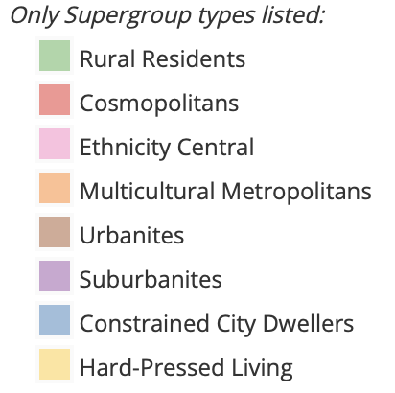
ONS Super groups
Source: ONS Super Groups by OA

Slide 49
ONS Sub groups
Source: Sport England, Active Lives Adults, Nov 17/18 to Nov 19/20 3 years combined
Notes:
3 years combined, no ONS data for first 2 years of the survey

Slide 50
Summary
Activity levels were going heading in the right direction before the pandemic struck and quite consistently!!!
The pandemic and the longer restrictions in Greater Manchester have had an impact
We need to try and get a bit more sophisticated about how we reach people that aren’t doing enough
We’ve got greater concern for:
  People aged over 55 especially those with a limiting illness or disability
  People from our more diverse communities
  With our younger children and our CYP from low affluence families – inside and outside of school
We need to keep an eye on how people get their minutes, it could be changing and there are implications to this
We may want to consider how we reach the following groups:
  Ethnicity Central
  Multicultural Metropolitans
  Constrained City Dwellers
  Hard Pressed Living

Slide 51
ONS Sub groups
Source: Sport England, Active Lives Adults, Nov 17/18 to Nov 19/20 3 years combined
Notes:
3 years combined, no ONS data for first 2 years of the survey

