Slide 1
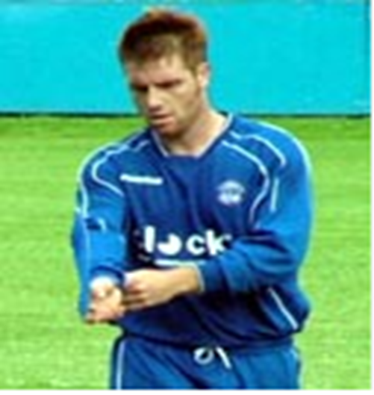
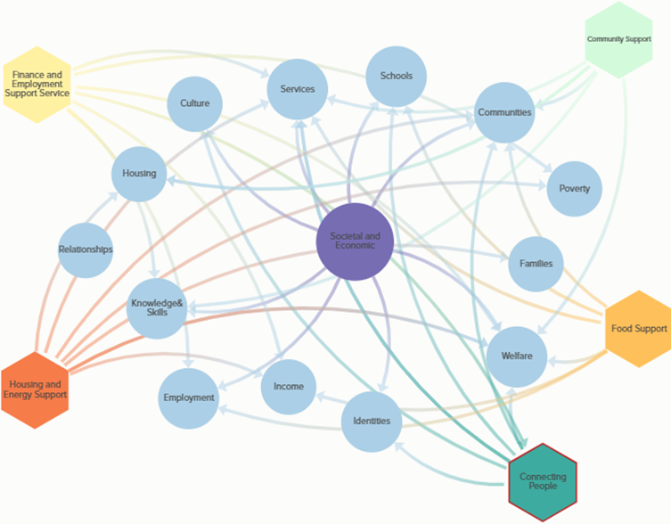
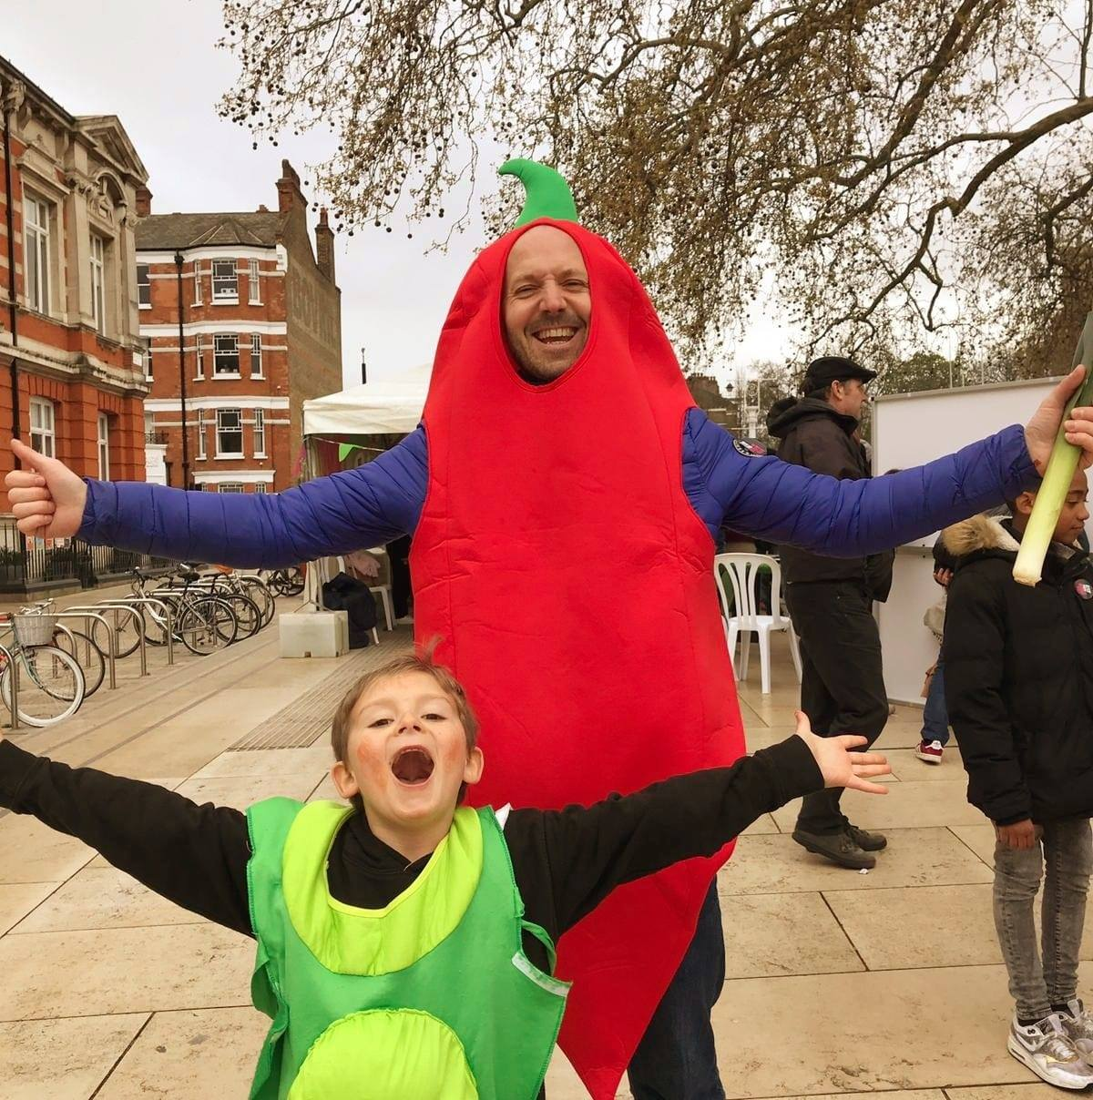
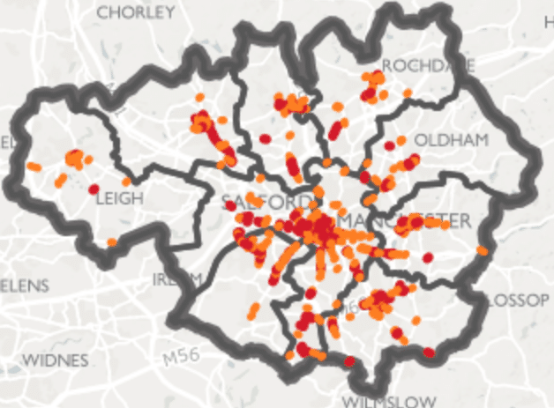
MENTAL HEALTH AND PHYSICAL MOVEMENT IN GREATER MANCHESTER
Ed Davie – Centre for Mental Health policy and public affairs manager
Lee Buggie – Bury Council public health specialist

Slide 2
IN THIS SESSION
Background
Our work in Bury and GM
Create your own physically active and mentally healthier GM

Slide 3
Dual-diagnosis/co-morbidity is common – eg problem drinking and depression
With right support people with a diagnosis can be happy and live fulfilling lives and many can make recoveries
There is debate about the usefulness of diagnostic terms and some treatments.
Trauma causes distress – many traumas can be prevented and distress can be alleviated
If someone appears to be in mental health distress practice active listening, try to empathise, help them access support and remember public sector safeguarding

Slide 4
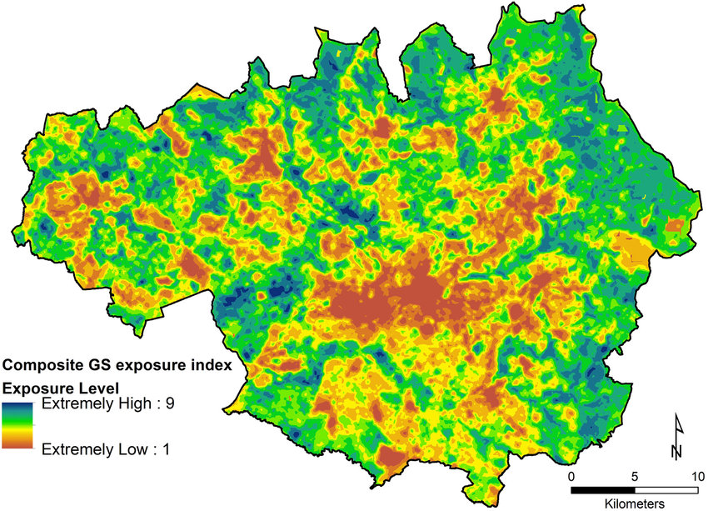
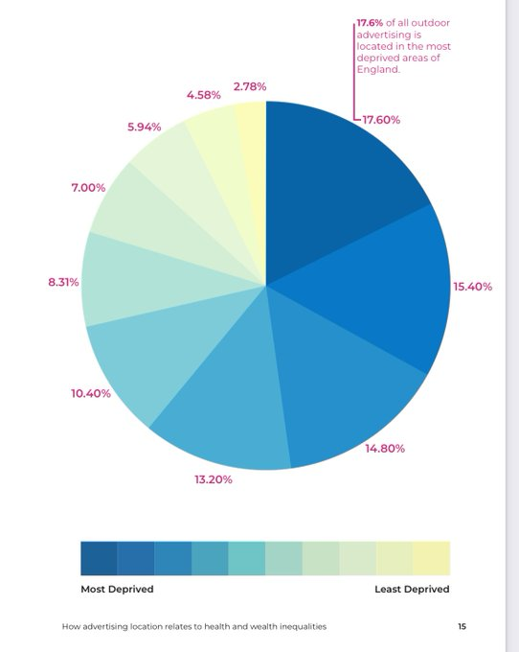
Social:
income, trauma, discrimination, upbringing, family/peer relationships, work, media, culture
Income influences environment
Social influences behaviour
Half of health outcomes
Behaviours:
Exercise, diet, smoking, alcohol, other substances
Environmental:
housing, pollution, access to green, community and supportive spaces
Mental health
Public health can influence behaviour
Inverse care law
Support:
Primary, secondary, social, community, public health maternity etc

Slide 7
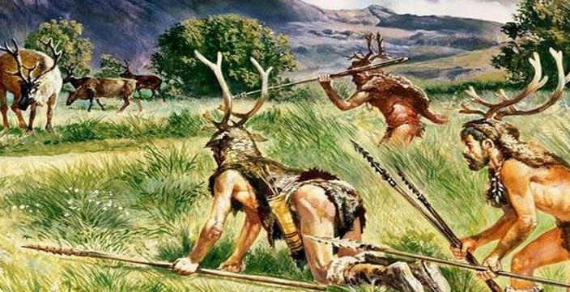
Our biology and psychology evolved to be:
Rewarded with dopamine for calories
1 Surrounded by natural environment
Stress hormone response to danger
Free from external control
Physically active
Close to our tribe

Slide 8
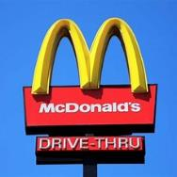
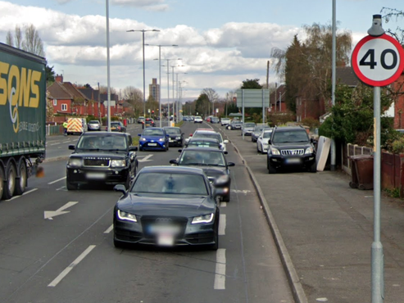
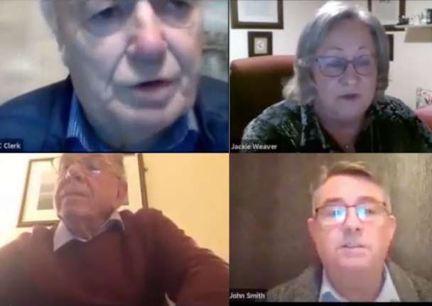
In contrast we've engineered environments that
Surrounds us with calories and alcohol
Poisons us with pollution
1 Controls what we are doing
Separates us from and damages nature
Minimises physical activity
Distances from other humans
Triggers stress hormones

Slide 9
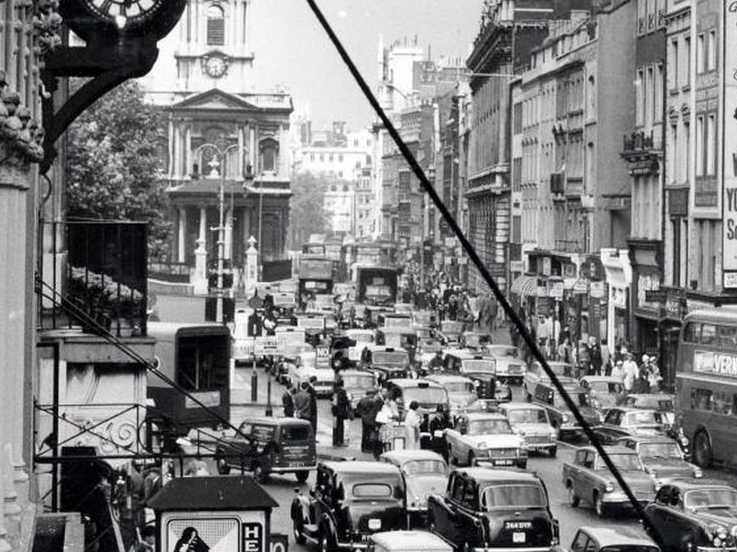
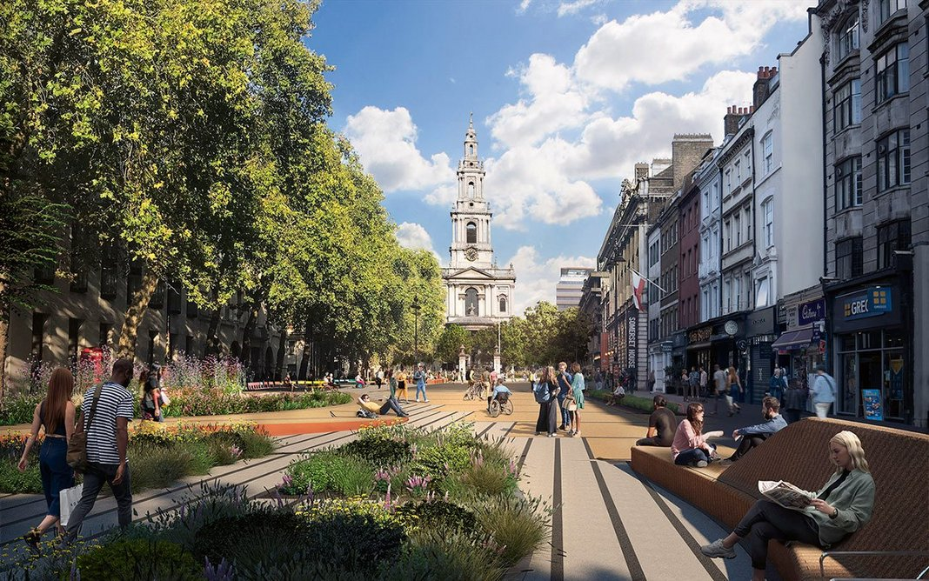
So little wonder we have:
A mental health crisis costing thousands of lives and over £2bn a year for each borough
An obesity crisis with 60% of UK adults and a third of children overweight or obese
An alcohol crisis – 25% drink harmfully
An environmental crisis – air pollution kills 40k in UK a year, climate change, habitat loss

Slide 10
So we need live more like our ancestors (in some ways)

Slide 11
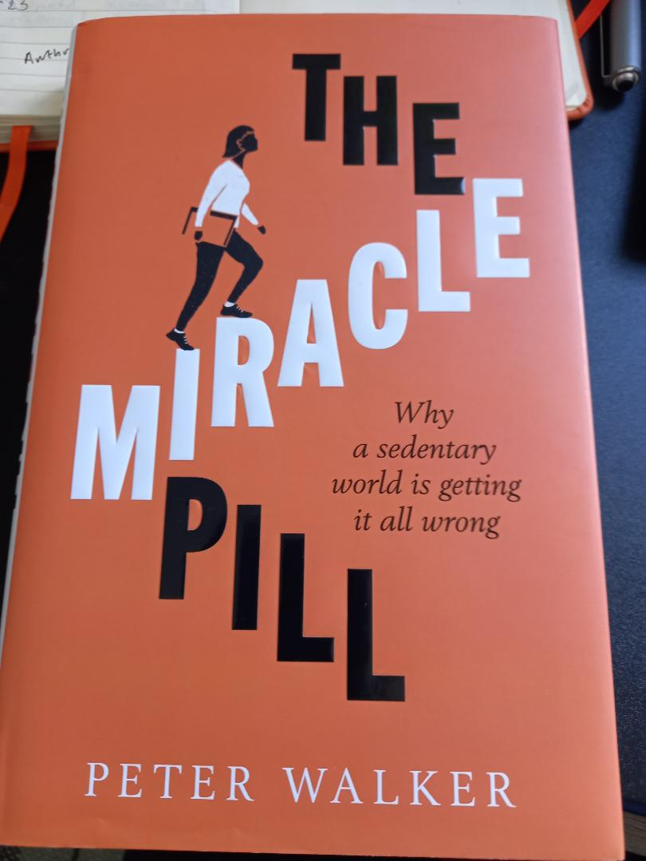
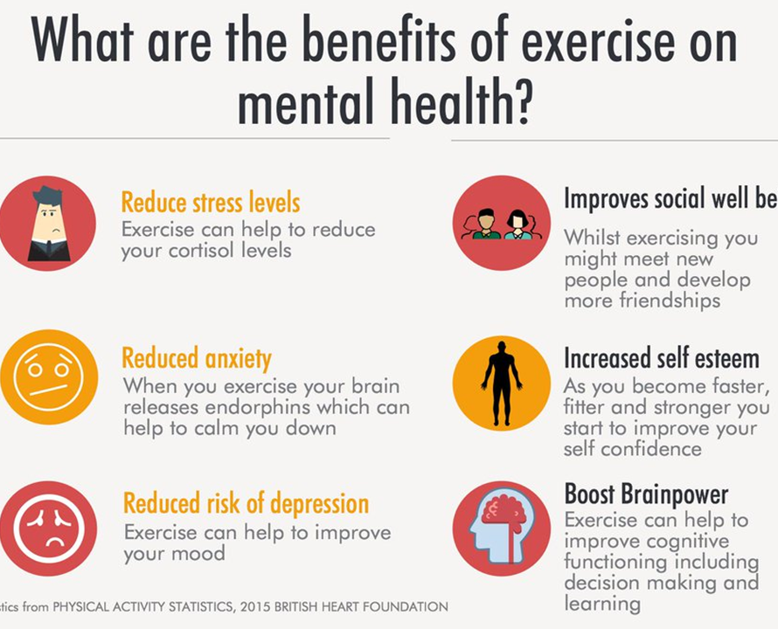

Slide 12
Hippocrates
‘If you are in a bad mood, go for a walk. If you’re still in a bad mood, go for another walk.’

Slide 13
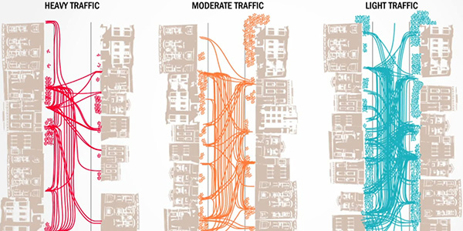

Slide 14
Greater Manchester has some of UK’s worst air quality, congestion and traffic accidents
Average nitrogen dioxide recordings for worst road in each borough:
Manchester : > four times limit
Rochdale : > three times limit
Salford : Nearly four times limit
Tameside : > four times limit
Oldham : Four times limit
Bolton : > four times limit
Wigan : > three times limit
Bury : Nearly four times limit
Stockport : > four times limit
Trafford : > four times limit

Slide 15
CREATING A MENTALLY HEALTHIER ENVIRONMENT
1 Medium density quality, affordable homes and mixed use
Plentiful green, waterway
play space
Copenhagen
Homes close to jobs, schools, shops and other amenities
Pro-social space – where people can meet others freely
Walking, cycling, public transport
prioritised
Clean air, healthy food, restricted alcohol and gambling
Regularly tops UN/WHO
Healthy/Happy City Indexes

Slide 16
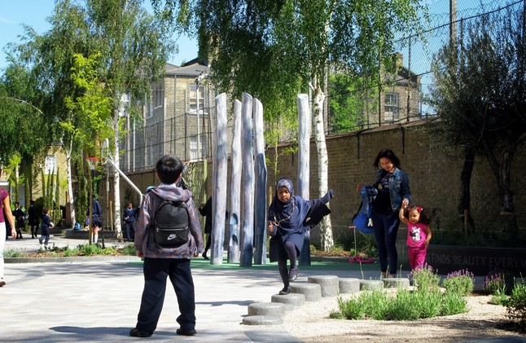
Mini Holland schemes with Waltham Forest
increased walking (115 mins/wk)
cycling (20 mins/wk)
Vehicle ownership decreased by 7% after three years,
No increase in emergency service response times,
18% reduction in crime after three years,
75% reduction in road injury collision risk.
Opposition decreased from 40% to 1.7%. All pro-LTN cllrs re-elected!
Health economic benefit of £724 m from interventions costing £80 m.

Slide 17
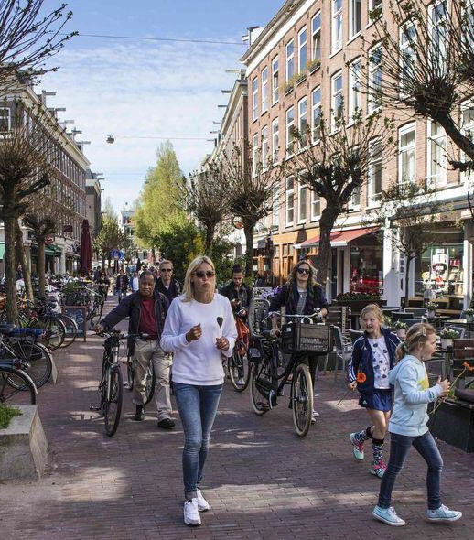
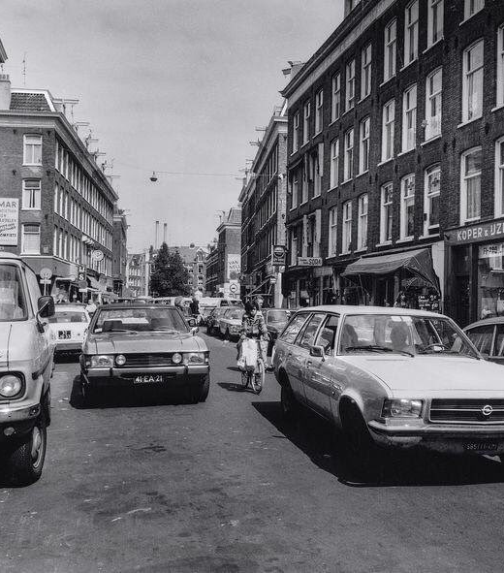
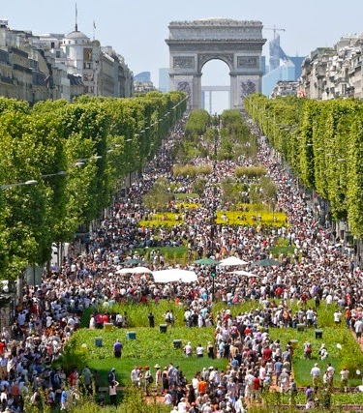
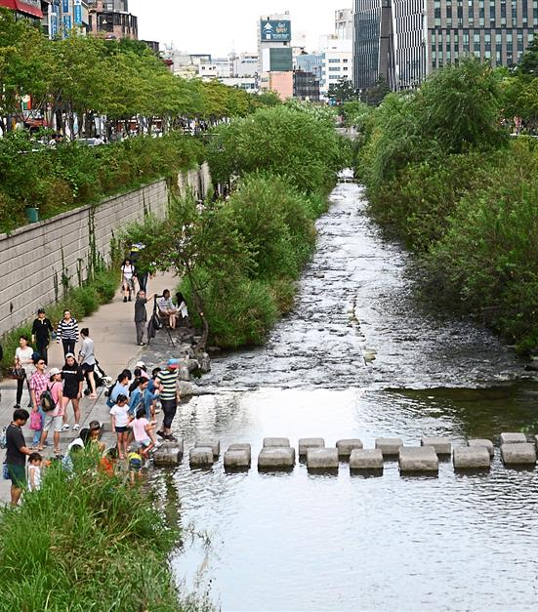
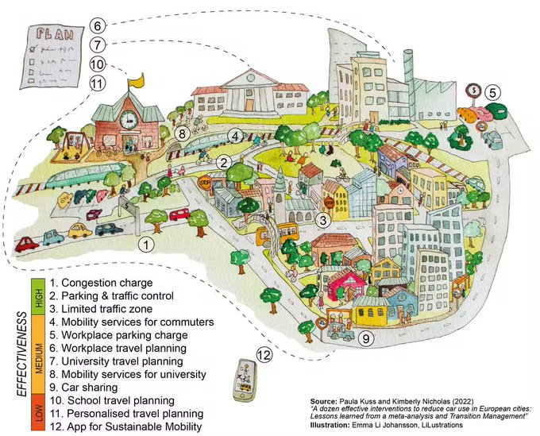
Be brave: prioritise people
80% of public space is given over to cars
Which have increased in size by 50% in 10 years
And in number to 40m in 30 years
Biggest source of C02, five a day killed in collisions, 117 air from pollution, 300 from diseases of inactivity (522 deaths a day)

Slide 18
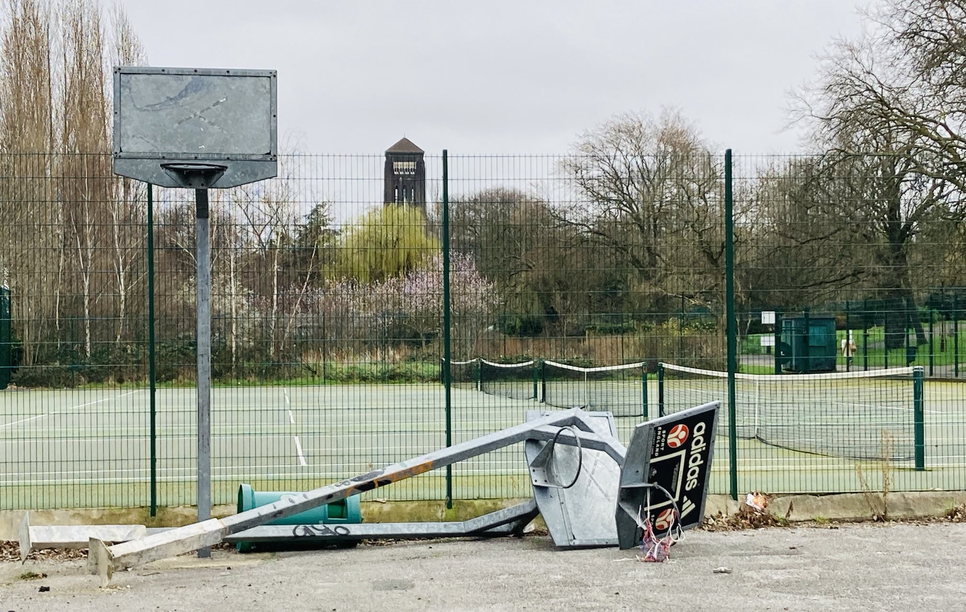
IS YOUR PARK STRUCTURALLY RACIST?
Sports injuries are the only poor health outcome that becomes more common with wealth
Invest in sports facilities and groups co-producing with racialised communities, women and girls, children and young people to ensure you are providing what will support those who disproportionately miss out

Slide 19
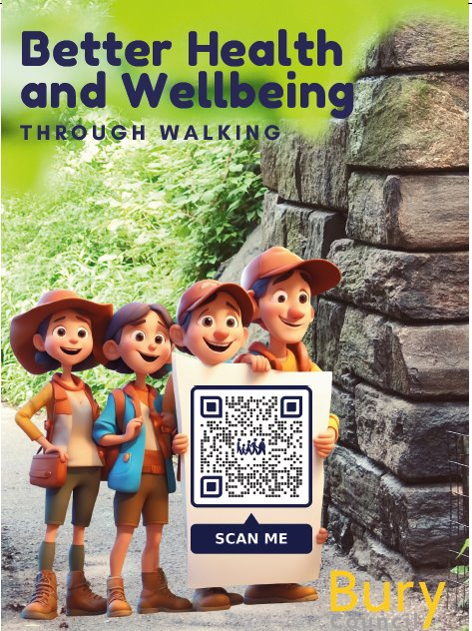
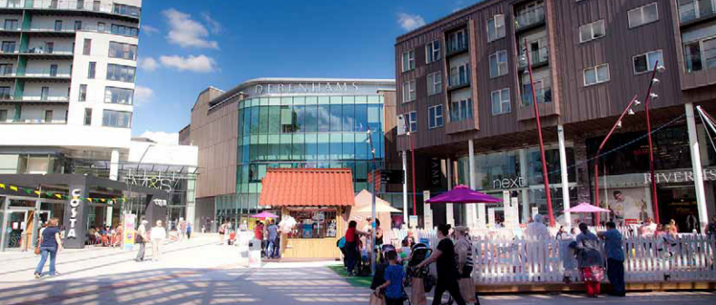
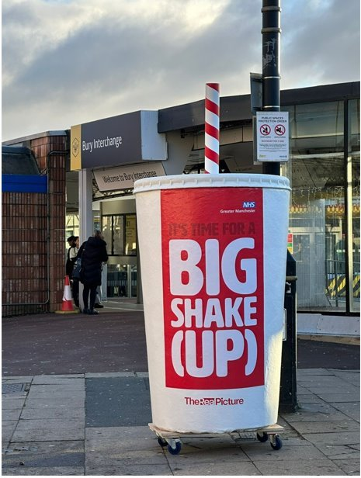
Bury Example – Physical Activity & Obesity
Inequalities
Open Green Space
Finite Resources
Excellent System working

Slide 20
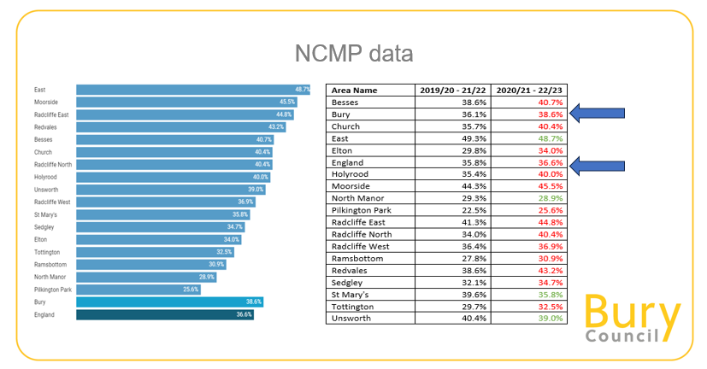
Bury Data
Notes:
Population : 195,000
Overweight and or Obese Adults : 64.9%
Active Adults = 69%
Overweight and or Obese Reception Children : 1 in 4
Active Young People =
Overweight an or Obese Year 6 Children : 1 in 2
Inactive Young People =

Slide 21
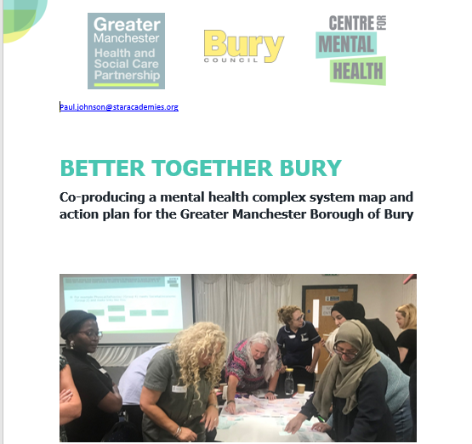
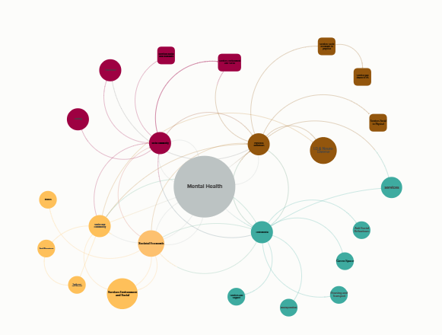
Bury Mapping Journey

Slide 22
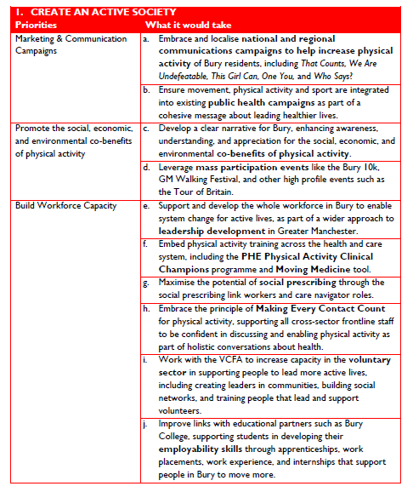
Bury Moving

Slide 23
Bury Moving Refresh: https://kumu.io/lee16/physical-activity-mapping

Slide 24
You are all powerful GM Mayor – create a more active GM
Address social determinants
Medium density – amenities/jobs/homes
Walking
Cycling
Public transport
Traffic restrictions
Planting, parks, waterways
Leisure centres
Sports clubs and facilities
Co-production with communities

Slide 25
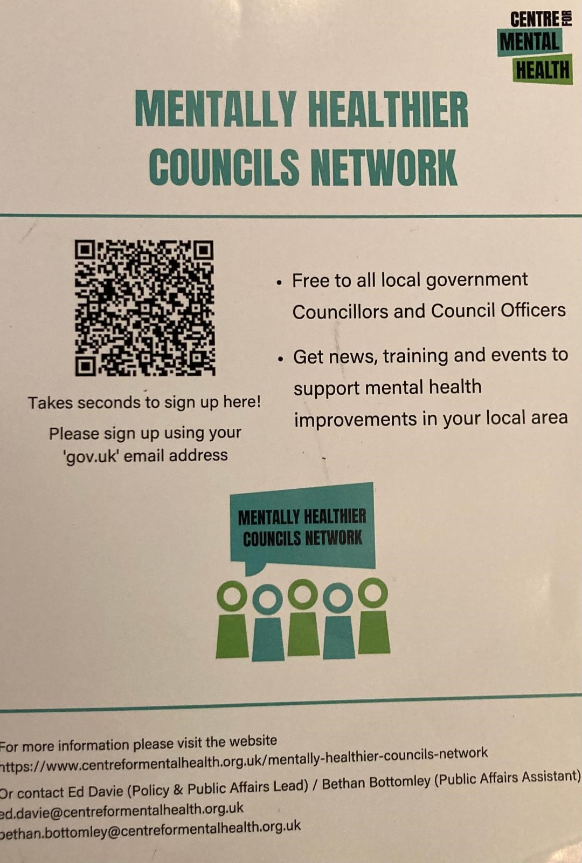
Thank you! And please join our team

