Slide 1
Positive experiences for Children and Young People :
Physical literacy in Greater Manchester
- concept to practice
Notes:
House keeping
Welcome
Great to see so many people in the room and from a range of sectors and organizations
My name/role
Workshop all about PL and how this can support PE for CYP
Thankyou for engaging as you came in- we will revisit this at the end of the session
Setting the conditions for today- open and honest
Get involved, whatever your role in the organisation is it doesn’t matter you will still be able to connect to this session today and take something away. – parent, sibling, work with CYP, coach CYP, work across the life course
A key moment in time across the sector to collectively shine a light on physical literacy and consider more deeply how embracing it systemically can really accelerate our efforts to drive positive experiences across the life course that build on the foundations for an active, healthy and happy life.

Slide 2
What words/thoughts/images come to mind when you hear the term
‘physical literacy’?
Draw or write on the paper around the room

Slide 3
Aims of the Workshop
What do we mean when we talk about ‘physical literacy’?
Why it matters to you and what it means to you?
Why it’s important to our work, your work, the work of the system in GM and wider, and nationally?
Notes:
What do we mean when we talk about ‘physical literacy’?- this will mean different things to different people/ or it might not mean anything- that’s okay- connect where relevant
Why understanding the concept of PL matters to you individually- Allow you to feel, connect and understand your relationship with PA , us at GM moving and why its an important concept for the system that supports CYP in GM to embrace.
Opportunity for you to think about how this might be considered within your work and how that supports the work across the life course on movement and PA both in GM and National

Slide 4
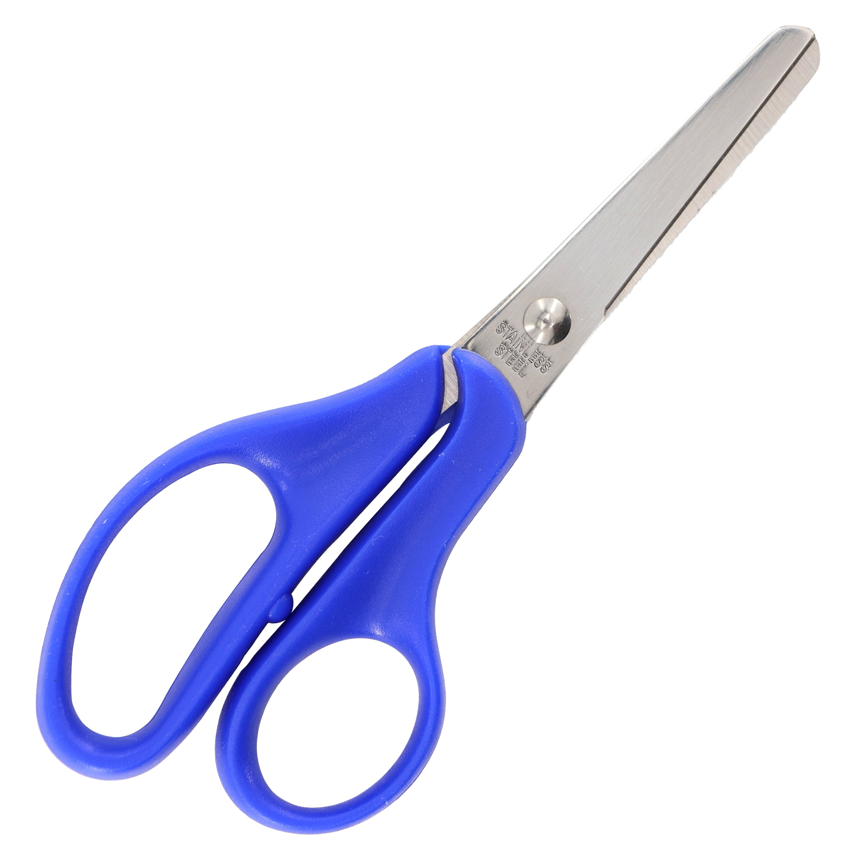
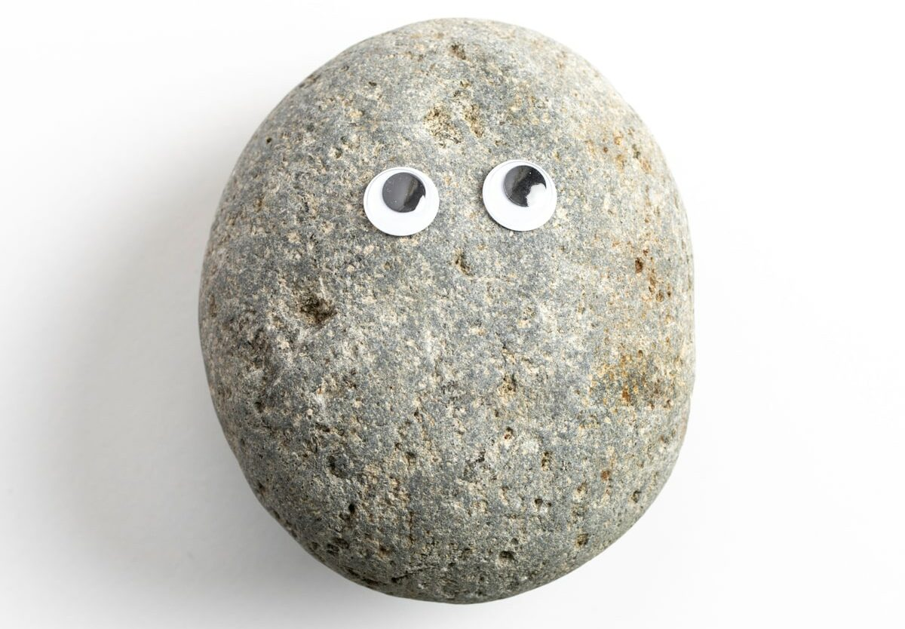
Rock, Paper, Scissors
Notes:
Rule – after 3

Slide 5
Notes:
What is PL - Official statement – graphic - Collaboration from across, education, health, academia, early years and the youth sector
Belongs to everyone – for us to consider and adapt how this fits for the work we do in GM and hopefully as mentioned at the start an opportunity for you to consider how this fits in your work where relevant.
Physical literacy is our relationship with movement and PA throughout life
Key differences with this statement/ consensus-
Consideration and focus on relationship throughout life
How PA makes us feel is key to PL and engagement (not just move)
Recognition that our relationship with PA is influenced throughout life- including the people we interact with, the communities we are part of, the culture we experience, and the places and space we move in all influence our PL. These could be postive or negative.
Understand starting point/ language/ Historically focused on the physical competence and that's why its been pigeon holed in CYP as its been about the development of those skills- not wrong but much broader than that and recognition that this Physcial literacy is right across the life course

Slide 6
Common Misconceptions
Just for children or the education sector
Only fundamental movement skills (FMS) or agility, balance and co-ordination (ABCs)
Delivered or taught
Achieved or accomplished- labelled as physically literate or illiterate
Another literacy (reading/writing) initiative taught through physical education or physical activity
Notes:
GM moving –
Just for children or the education sector – GM moving really keen to ensure that the workforce understand that PL is relevant right across the life course
Only fundamental movement skills (FMS) or agility, balance and co-ordination (ABCs)
Delivered or taught – Physical activity is the action, the behaviour change, the outcome we are wanting to see. You build your relationship with PL- Physical activity is the action, the behaviour change, the outcome we are wanting to see.
Achieved or accomplished- labelled as physically literate or illiterate – don’t ever stop developing and building your physical literacy
Another literacy (reading/writing) initiative taught through physical education or physical activity
Physical activity is the action, the behaviour change, the outcome we are wanting to see.
Physical literacy is how we think, feel, move and connect to find enjoyment, meaning and value in movement and physical activity to drive lifelong engagement and participation.
Physical literacy and physical activity are interconnected- physical literacy shapes our relationship with physical activity and physical activity develops our physical literacy.
ay you speak to people about ‘new consensus’ PL as a concept as starting points are different.

Slide 7
So, What… Why does ‘physical literacy’ matter?
Notes:
Pictures show the importance of PL to us in GM
Joy in the movement
Life long

Slide 8
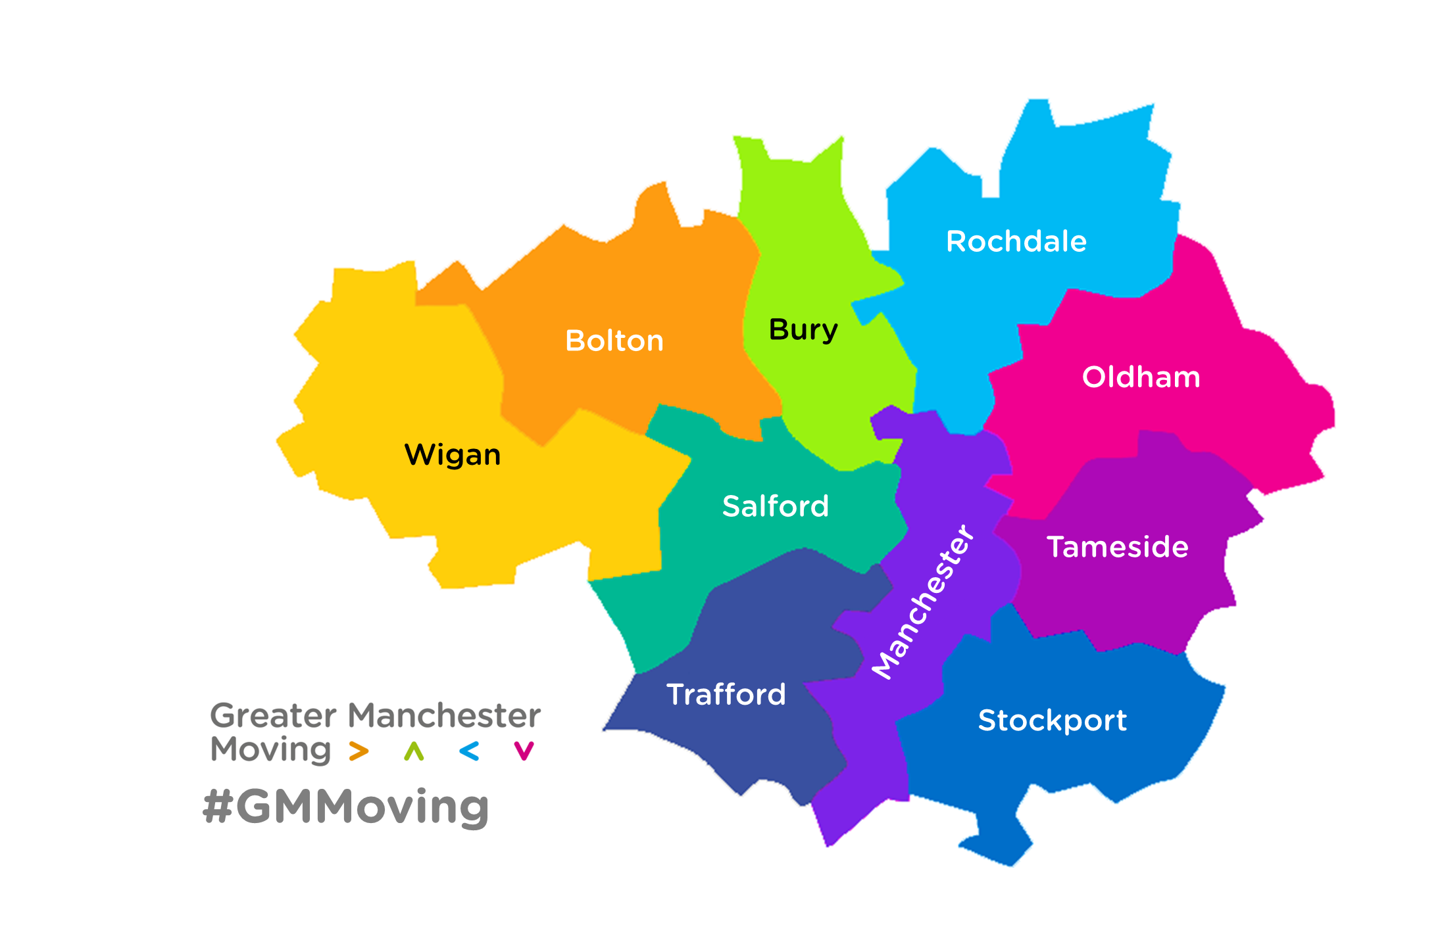
At Greater Manchester Moving we know moving matters to all of us.
Why does it matter?
What made it matter?
Notes:
Why we have decided to embrace this concept in GM
At GM moving – as a team and through the work we do with partners we all value to importance of movement,
Do we know why it matters, what made it matter, and what will continue to make it matter?
This is what we have been considering off the back of the back of the PL consensus launch.
Understanding peoples relationship with activity (their PL) is crucial to then providing postive experiences to support engagement with movement PA throughout life
Is it something you can consider through your work and partners – opportunity to think more about this in the next couple of table activities
CYP team-
Starting, continuing and changing the conversation about CYP movement to consider how any opportunity for a young person to move, also allows them to reflect on how they feel, learn and connect to build a positive and meaningful relationship with movement.- drives our work around Youth Voice, Active schools, Open Schools Facilities.

Slide 9
Physical literacy is our relationship with movement and physical activity throughout life.
What you’ll need:
- A coin
Pen and paper
Your memory!
Notes:
So what does this mean for you

Slide 10
Our relationship with physical activity
Engagement with PA
Age
How did the type of activity/movement you took part in change overtime, and why?
If/ when you have been disengaged with physical activity? Why was this?
When did you get the most, value, meaning and enjoyment during the engagement in PA?

Slide 11
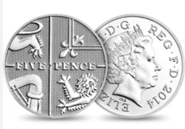
Did you get value, meaning and enjoyment during the engagement in PA?
How did you move, think, feel and connect?
Who/ what were the systems, cultures and influencers that allowed you to take part?
Notes:
So what does your relationship with PA look like?
Coin Activity – unlock your understanding of physical literacy
Connect personally
Think about how PL is affected throughout your life – points in time in you life and how this relationship has changed over time
Date on the coin- how old were you, what were you doing at this point in your life and what was your relationship with physical activity?
What was the movement/ PA at this point in time and did it give you meaning value and enjoyment
What did it involve, how did it make you move, feel, learn, connect (learn and develop)
Who and what were the enablers/systems- social and environmental factors that allowed you to do this?
How did this experience/ opportunity/ PA movement opportunity influence or change or your future relationship with PA?
Swap coins
Thankyou for taking part/ please consider how this activity has made you think about the language you might associate with PL and what it means to you but also to your work.
If we, our partners and the system value the importance of understanding a persons relationship with activity and movement we can ensure we provide positive experiences and opportunities... an example of where this was done within our work is the story that Lauren will share

Slide 12
Physical literacy is our relationship with movement and physical activity throughout life.
Table conversation – partner and then share on flip chart
• What's my role?
• What's my organisation's role?
• What's the challenge?
• What's the opportunity?
Notes:
So what does this mean for you

Slide 13
What words/thoughts/images come to mind when you hear the term
‘physical literacy’?
Draw or write on the paper around the room
Notes:
Thankyou for taking part/ please consider how this activity has made you think about the language you might associate with PL and what it means to you but also to your work.
If we, our partners and the system value the importance of understanding a persons relationship with activity and movement we can ensure we provide positive experiences and opportunities for more CYP

Slide 14
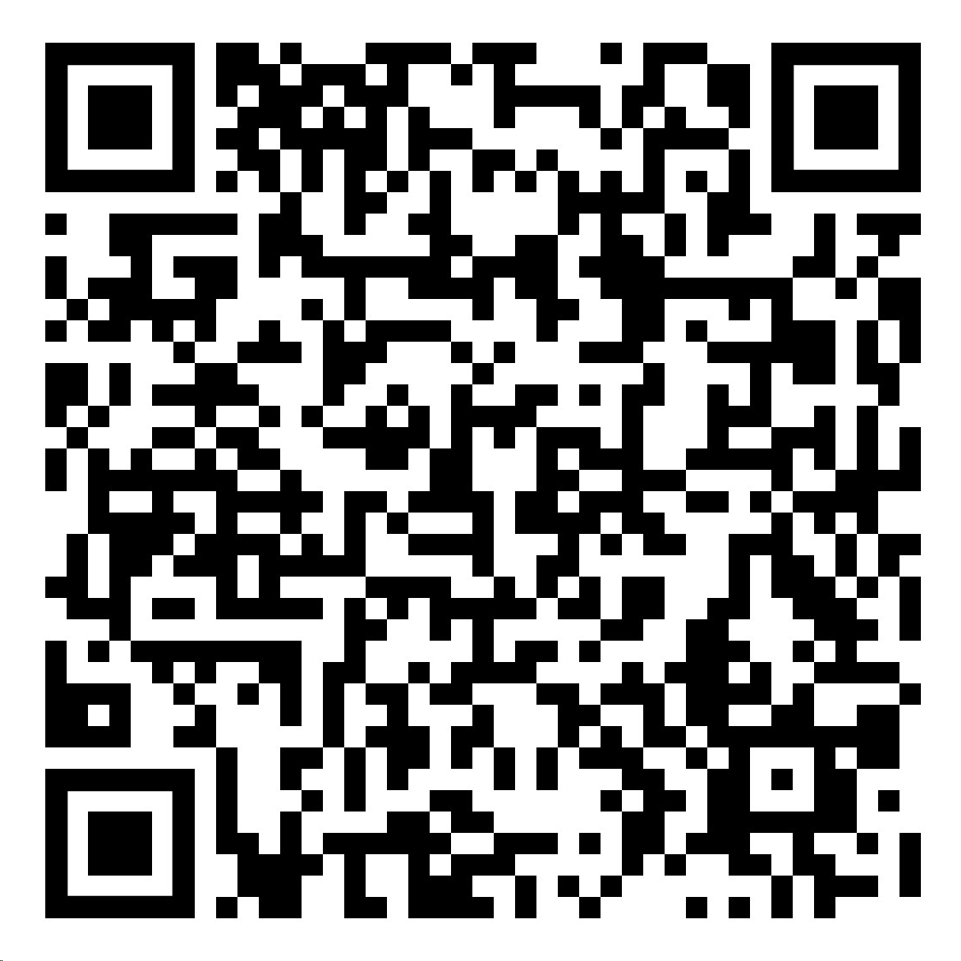
Thank you
Scan for more information on the Physical Literacy consensus Statement
Notes:
CYP team-
Starting, continuing and changing the conversation about CYP movement to consider how any opportunity for a young person to move, also allows them to reflect on how they feel, learn and connect to build a positive and meaningful relationship with movement.
Did you win/ How many points did you score?
How do you feel when you take part?
Why do you like moving in that way?
What did you learn?
How did that make you feel?
Aside from the physical skill and ability
Relationship
Connection
Feelings
Experiences
Language
Social media/comms
Our job as AP's to support system partners to- communicate so our partners and stakeholders understand the need for postive experiences and the opportunities that lead to the social and physcial experiences that link to life long participation

