Slide 1
Active Workplaces #Active Soles
Hexagon Room
Notes:
Movement matters to us all, it matters to workplaces.
We need to design movement back into our everyday life and where we work.
We all have a role to play
Movement matters to us all, it matters to workplaces.
We need to design movement back into our everyday life and where we work.
We all have a role to play

Slide 2
Workshop Aims and objectives
To increase understanding of why taking a whole-workplace approach to physical activity in the workplace matters and,
Explore possible interventions that can be taken at the different layers of the system.
To increase understanding of why language is important and,
Explore how words and language can affect mindsets, attitudes, and behaviours related to health and wellbeing in the workforce
Notes:
This workshop will explore why a whole-workplace approach to developing more active workplaces is important to support improved employee health & wellbeing to create more engaged and productive workforces.
It will look at why framing is important and explore different types of messaging/engagement techniques people can and have used across the layers of the workplace ‘system’.

Slide 3
Who Are We?
Claire Marshall, Strategic Lead – Active Adults, GM Moving
clairemarshall@gmmoving.co.uk
Hannah Lloyd, Principal Public Health Practitioner, Betsi Cadwaladr University Health Board
hannah.lloyd4@wales.nhs.uk
Alex Wood, Senior Health Promotion Specialist, Cardiff & Vale University Health Board
alex.wood@wales.nhs.uk
Dawn Mitchel, Head of Physical Activity & Health, Cardiff Met University
dlmitchell-williams@cardiffmet.ac.uk

Slide 4
Our Journey So Far….
GM Moving Conference
February 23
Move More Cardiff Strategy & Active Soles launch
June 23
Actif North Wales
Active Soles launch
July 23
Spread & Scale, Cardiff
October 23
Active Workplace CoP & Relaunch of Active Soles in GM
January 24

Slide 5
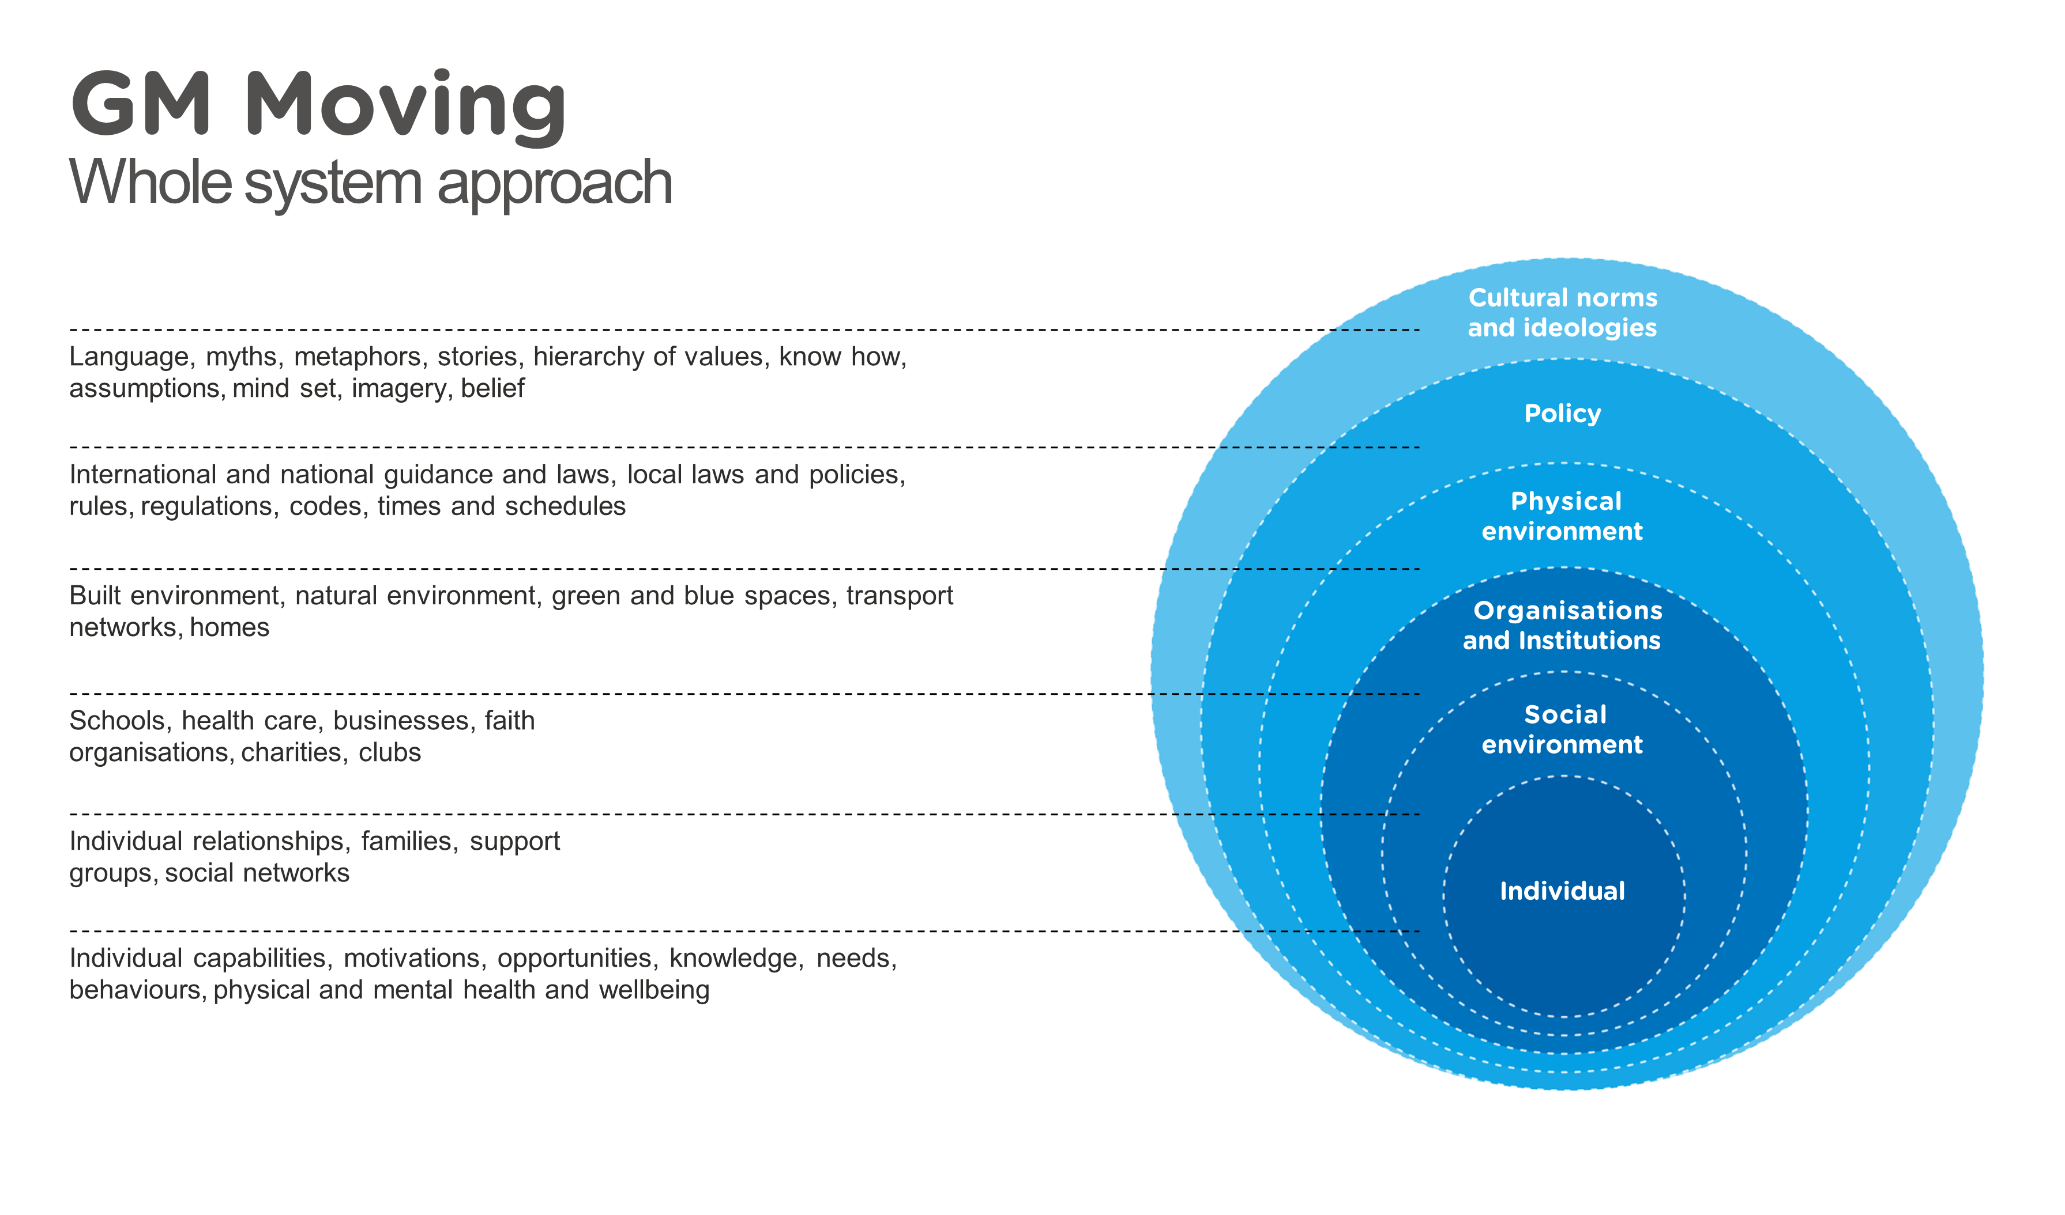

Slide 6
Task :- On your tables, discuss the different types of interventions for each level (culture – individual) of the onion model.

Slide 7
Language and Mindsets

Slide 8
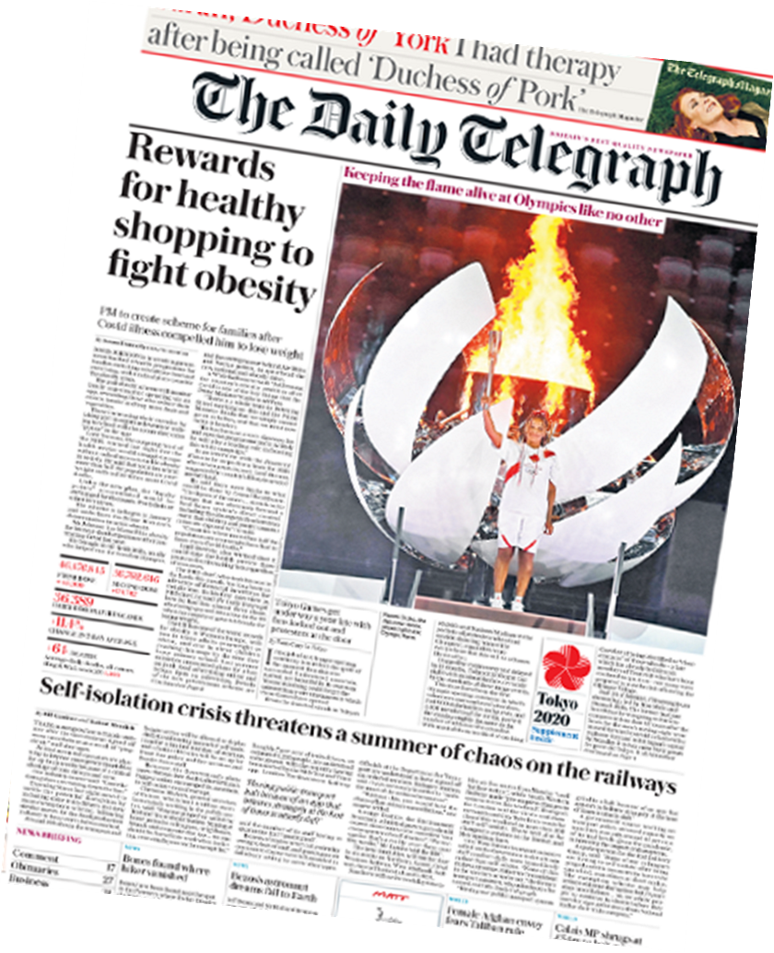
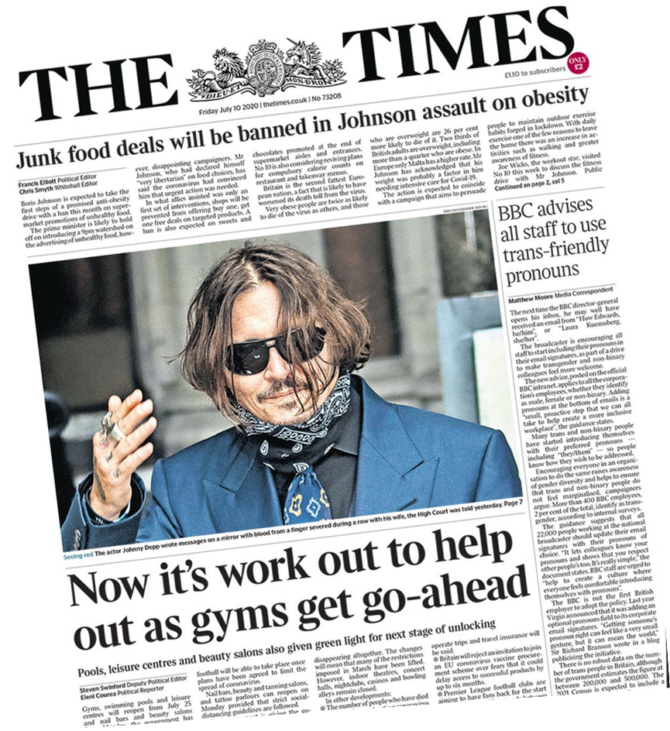
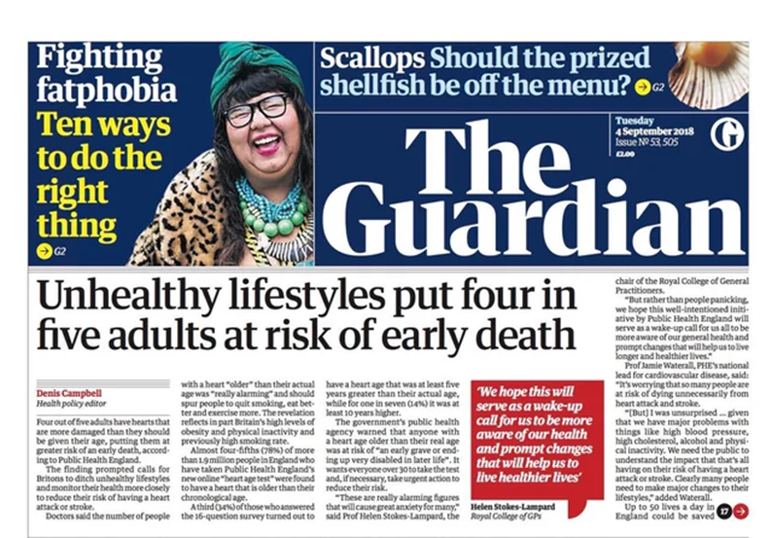
Notes:
Often people think how active you are or your weight is one of personal responsibility. If you look at headlines in British Newspapers this is how it is being sold as a narrow view of personal responsibity …
Rewards for healthy shopping, it’s work out to help out as gyms get go ahead, exercise more to help the Welsh NHS and people rarely disagree “she’s right peoples diet and exercise is shocking, okay give me £300 for gym membership”
British newspapers doubled the amount of reporting on obesity between 2008 and 2017. These newspapers increasingly emphasise individual factors like biology and personal choice when writing about obesity. Emphasis on political and social factors has decreased in news over time. Personal choices play a relatively minor role in the growth of obesity and it doesn’t explain growing obesity rates.
And this is important because we need to know what the default belief is, this isn't just the public but the people we work with (they are the public out side 9-5) that are likely to have this mind set. If we are only thinking about the individual and we don't step away to see the wider picture then we'll agree upon the wrong solution. So what is the answer, a whole systems approach... not looking at a small part and hoping that that will make a difference to an individual .​
​

Slide 9
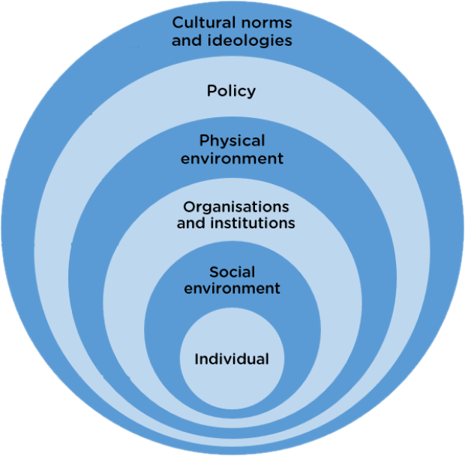
Likelihood of sustainable impact
Ease of implementation
Notes:
This morning we have been working on the onion model,

Slide 10
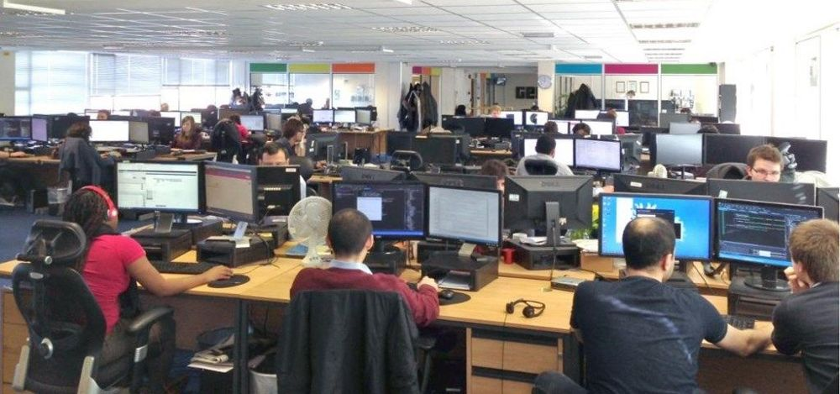
what surrounds us, shapes us…

Slide 11
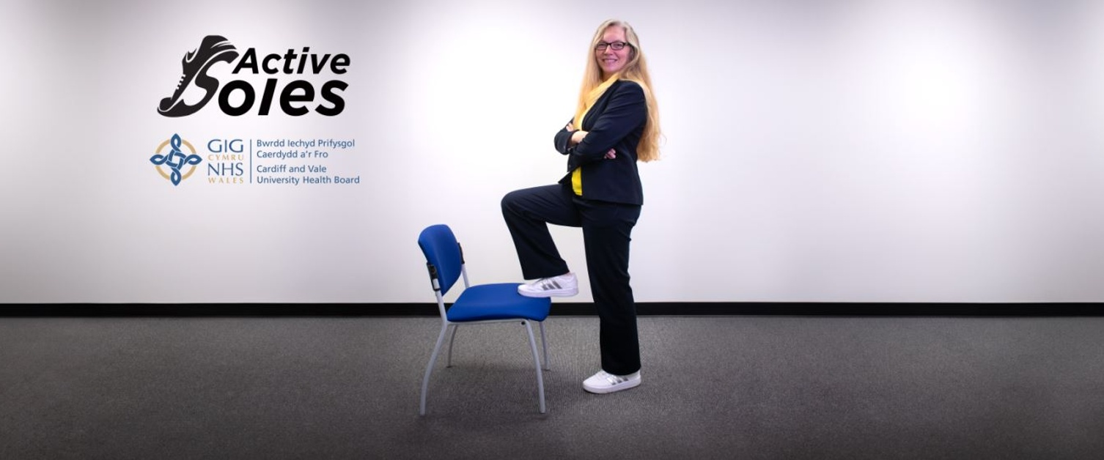
#Active Soles

Slide 12
A theory of change
worldview hierarchy of values
To be seen as professional and credible Workwear = smart suits and high heels
Mindset Language
I’m a senior leader and I need to be seen to be smart
Behaviour
High heels, formal shoes, changing shoes under desk
Outcome
Inactivity
Poor health
MSK
Poor mental wellbeing
Stuckness!
worldview hierarchy of values
People dress in a way that enables them to do their best work
Mindset Language
The best work gets done when I feel at ease and comfortable
Behaviour
Walking meetings, active soles, standing desks, thinking walks, active travel, reduced car use
Outcome
Activity
Productivity
Creativity
Health
Wellbeing
Problem solving
Environmental benefits

Slide 13
A theory of change
worldview hierarchy of values
Real work is done at a desk
Mindset Language
‘Going’ to work, work is where you are
Behaviour
Working in office at desk
Outcome
Inactivity
Poor health
MSK
Poor mental wellbeing
Stuckness!
worldview hierarchy of values
Real work is what you think/do, not where you are
Mindset Language
I’m working and thinking
Behaviour
Working how and where works for the need
Walking meetings, standing desks, thinking walks
Outcome
Activity
Productivity
Creativity
Health
Wellbeing
Problem solving

Slide 14
In groups of three, answer three questions
How do the words we use affect our beliefs, attitudes, and behaviours for movement and wellbeing in the workplace? Any examples?
What words and language resonates to get workplace health / movement onto the agenda? What is the story we tell?
Would we use different language, words or stories for the rings/levels of the onion?

Slide 15
Active Workplaces: What’s Next?
Join the Community of Practise:
Monday April 22nd 1pm-2.30pm
Language, Messaging and Framing
Thursday July 11th 10am-11.30am
Measuring Impact and Learning
Tuesday 15th October 1pm-2.3pm
Influencing Stakeholders, Senior Leaders and Culture.
Notes:
Movement matters to us all, it matters to workplaces.
We need to design movement back into our everyday life and where we work.
We all have a role to play
Movement matters to us all, it matters to workplaces.
We need to design movement back into our everyday life and where we work.
We all have a role to play

Slide 16
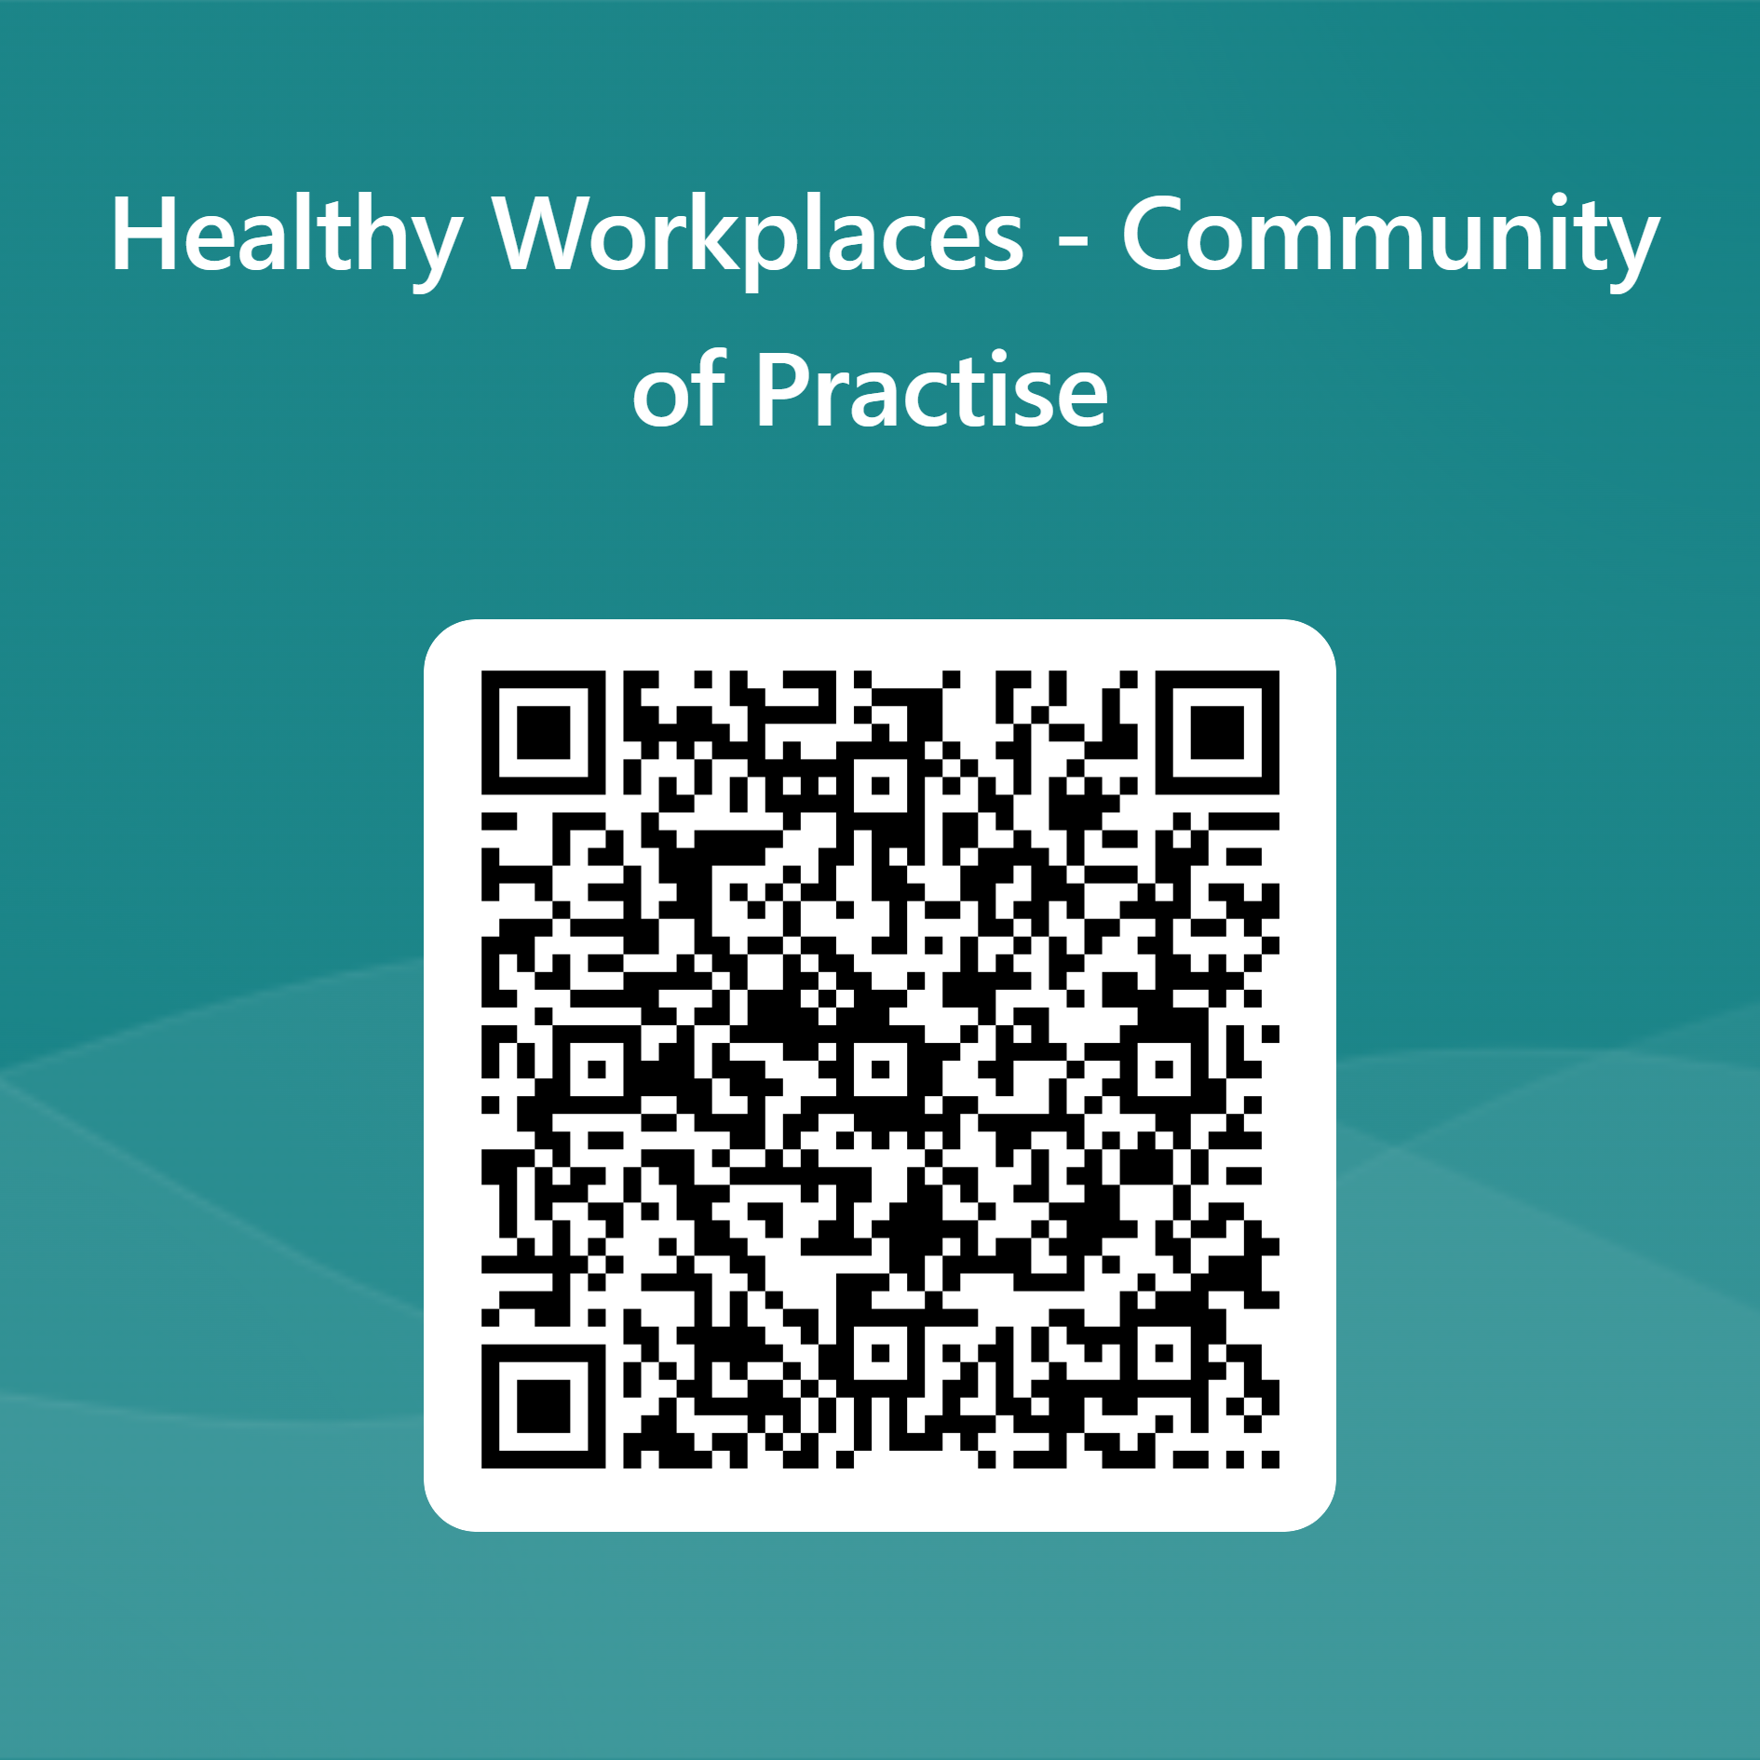
Interested in joining?

Slide 17
Thank you for your time today… Any questions?

