Slide 1


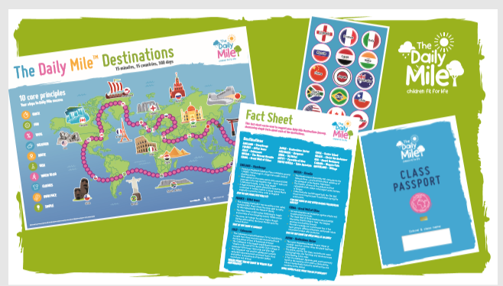

Matt Domville
The Daily MileTM Local Co-ordinator
Greater Manchester

Slide 2












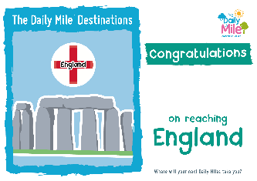

What is The Daily Mile Destinations?
The aim of The Daily Mile Destinations challenge is for each classroom (teachers and pupils) to work together to complete 100 days of The Daily Mile
Classrooms compete to reach all of the destinations and fill their classroom passport
Once classrooms reach a destination, it is time to add your destination sticker to your passport as proof of your visit

Slide 3
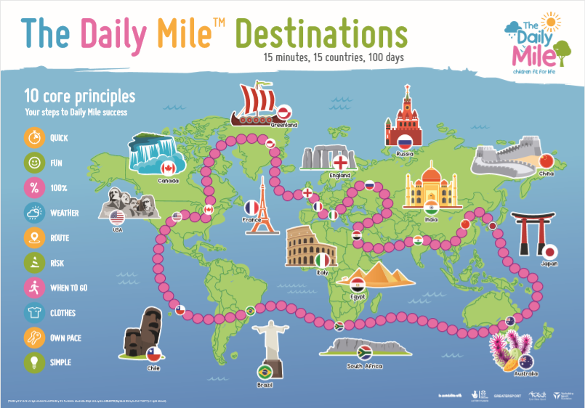
Lets take a closer look!
The Map and The Marker
As a classroom you can start your journey at any destination on the map… the choice is yours
Lets say you decided to start in England. It would take you two ‘Daily Mile days’ to get to France

Slide 4
What about the marker?
The Map and The Marker
Each classroom get their own marker to move around the destinations map
Be sure to you add your classroom name to the marker
Every time you complete a day of The Daily Mile, move your marker closer to your new destination.
Class 5C

Slide 5


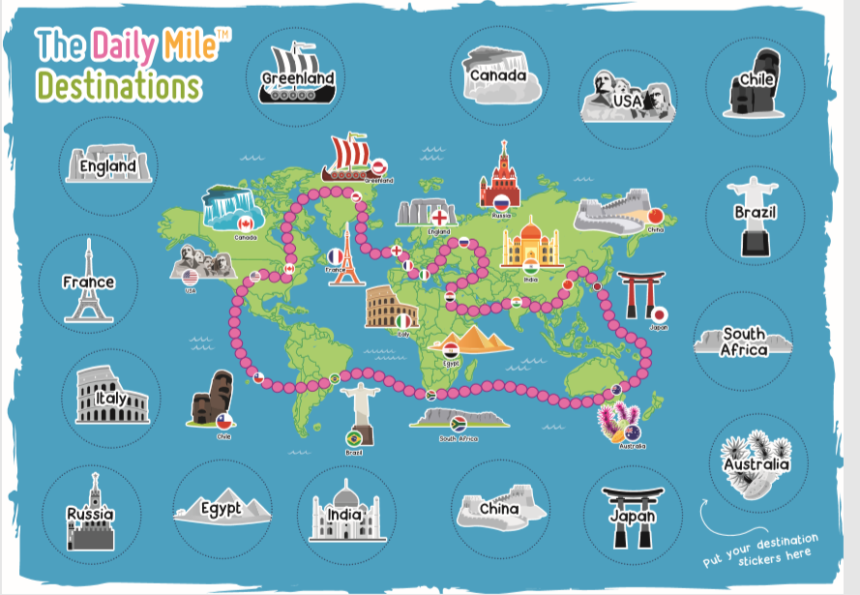


Passports Please!
2. The Classroom Passport
Place the classroom passport in your classroom for everyone to see
Each time you reach a NEW destination, add a sticker to your passport
Remember there are 15 stickers to collect

Slide 6


Certificates!
3. Certificates for show.
Each time you reach a new destination, your class receives a new destinations certificate
Added to this, their are some fun facts to learn and questions to conquer for each destination
For example…

Slide 7

And Finally..!
4. …If my class collects all the stickers?
Your class receives the *SECRET GOLDEN* The Daily Mile Destinations Certificate
This certificate entitles your class to enter into a prize draw to win ‘one of 5’ activity fun buses to come to your school FOR THE DAY
So… where will your next destination take you?

Slide 8


